Slide 1
Cells

Slide 2
Size
What’s small?
How small is small?
What is the smallest living organism that you’ve ever seen?
Most people can only see objects that are 0.1 mm or larger, that’s the thickness of a sheet of paper!

Slide 3
Salt Grain
Can you imagine splitting a grain of salt into two?
What about 4?
What about 10?
What about 100?
What about …

Slide 4
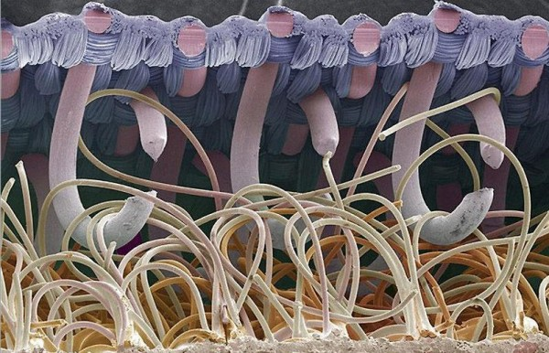
Velcro

Slide 5
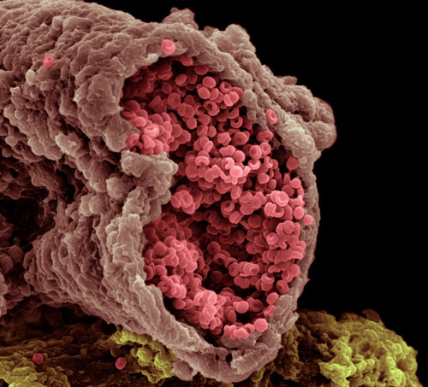
Artery and Red Blood Cells

Slide 6
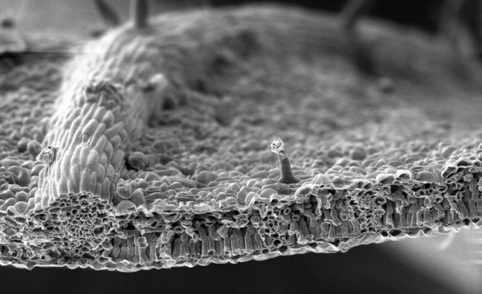
Leaf

Slide 7
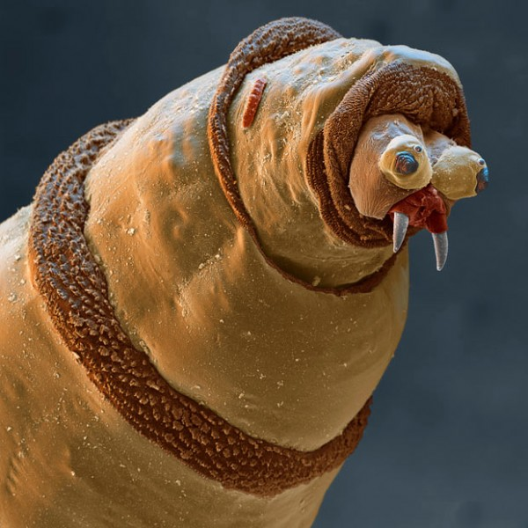
Maggot

Slide 8
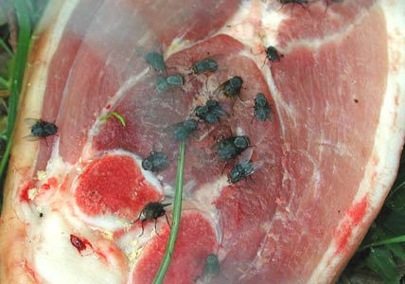
In past centuries, it was common belief that maggots, flies and even mice, could be produced from non-living material such as air and water. Aristotle, Greek philosopher, rejected the idea that life came from rain and thought life came from mud or rotting meat.
This idea was called spontaneous generation and was used to explain the magical appearance
of maggots on decaying carcasses.
This theory lasted for nearly 2000
years!

Slide 9
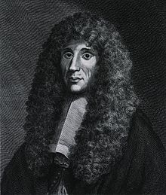
Discovery
It wasn’t until 1668 when Francesco Redi determined that the maggots came from eggs laid by flies.
Redi created an experiment using two jars that contained meat. One jar was sealed and the other was kept open.
The opened jar attracted flies and eventually maggots appeared. The sealed jar remained
unchanged.
The maggots eventually became flies
and Redi theory was proof.

Slide 10
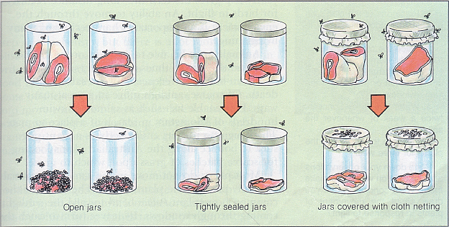
Redi’s Experiment

Slide 11
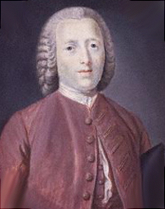
Although Redi helped defeat the theory of spontaneous generation for flies the theory still lingered for microorganisms.
Scientist John Needham(1713-1781) noticed that meat broth smelled putrid when left unsealed. He boiled the broth to kill any microbes (microorganisms) but after a couple weeks the microbes came back.

Slide 12
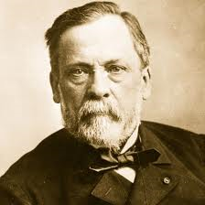
Experiments
Despite Redi’s experiment and Needham’s observations, many people still believed in spontaneous generation until Louis Pasteur, a French chemist, did a controlled experiment that confirmed that bacteria and other single-celled organisms are carried in the air on dust particles and water vapour.
After Pasteur’s famous experiment the theory of spontaneous generation was finally abandoned. We learned that micro-organisms come from other micro-organisms.

Slide 13
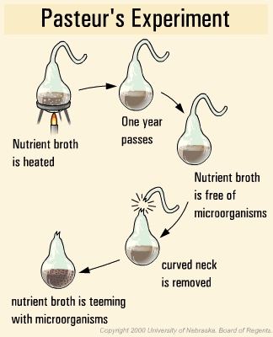

Slide 14
Cell Theory
Following the discoveries of Redi and Pasteur, German scientist, Rudolf Virchow, and two other colleagues, formed a set of hypotheses called the Cell Theory.
All living things are made of one or more cells.
Cells are the basic unit of structure and function in all organisms.
All cells come from previously existing cells.

Slide 15
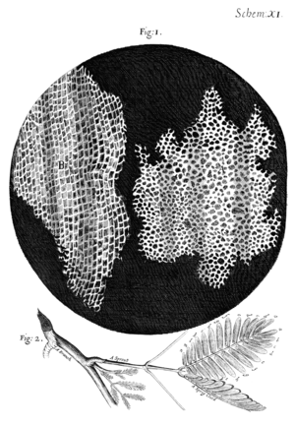
Cells
Cells are the individual, living units that make up all organisms. The name cell comes from Robert Hooke(1635-1703) who coined the term cellulae when he observed tree bark under a microscope.
Some organisms are multicellular(2 or more cells) and others are unicellular(single cell). Most microscopic organisms are unicellular organisms.

Slide 16
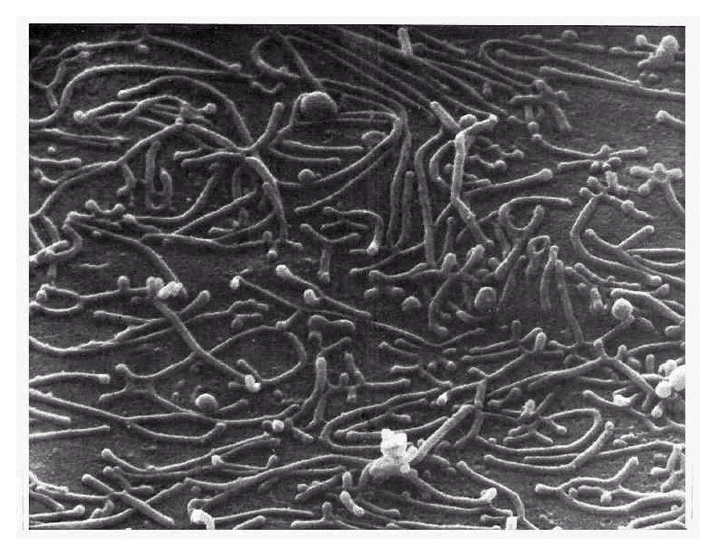
Small
The smallest kind of organism known to humans that are capable of growth and reproduction are called mycoplasma.
Even though this organism is tiny it is still comprised of millions of particles.

Slide 17
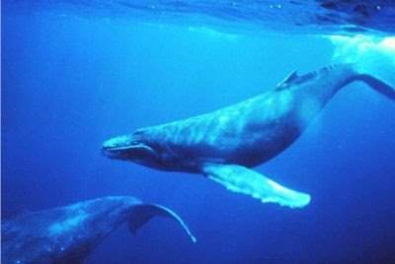
Large
The largest animals known to humans are blue whales. However, the largest organism is a fungus that covers an area of 1665 football fields, it’s also estimated at 2400 years old!

Slide 18
What Does Mycoplasma And a Blue Whale Have in Common?

Slide 19
Whales and mycoplasma have much in common as they are both living organisms and both are made up of cells.
Questions to Consider
How might the cells of a multicellular blue whale be different from the cell of the unicellular mycoplasm?
How might your cells be different from the cells of another animal or plant?

Slide 20
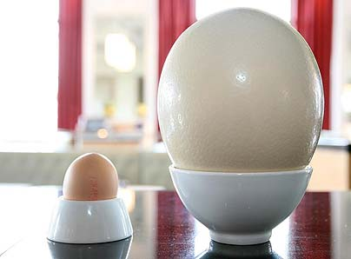
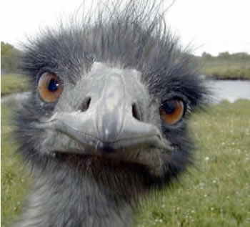
Largest Single Cell on Earth?

Slide 21
Cells
Structures in cells have specific functions, these structures are called organelles.
Cells have:
a “command centre” that directs all cell movement, growth, and other life functions
a “power source” to provide energy for carrying out those activities
a “controllable gateway” that lets in needed material and lets out waste material.

Slide 22
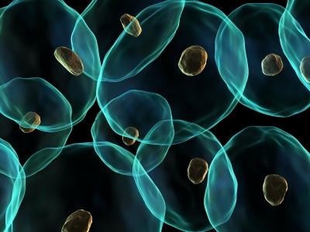
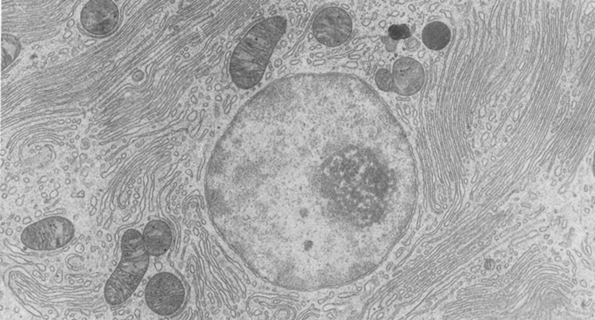
Cell Structure(Organelles)
Nucleus – Often the most easily seen structure in a cell, it is often round and found near the middle of the cell. The nucleus is the control centre of the cell that directs all activities of the cell.

Slide 23
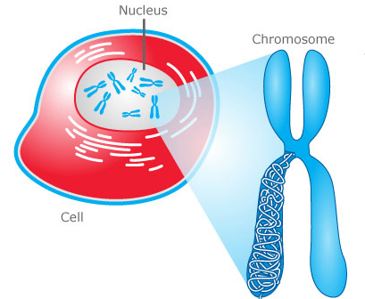
The nucleus contains genetic (hereditary) information that is organized into threadlike structures called chromosomes. Each chromosome contains different genes.
Genes are groups of genetic information that determine the specific characteristics of an individual.

Slide 24
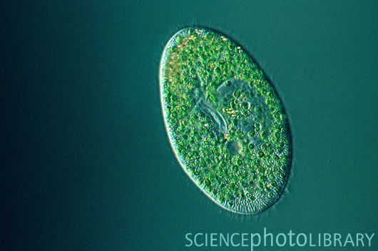
Cell Membrane – a thin layer that surrounds the whole cell and protects the cell’s contents. The cell membrane is like the gatekeeper that controls the movement of materials in and out of the cell.

Slide 25
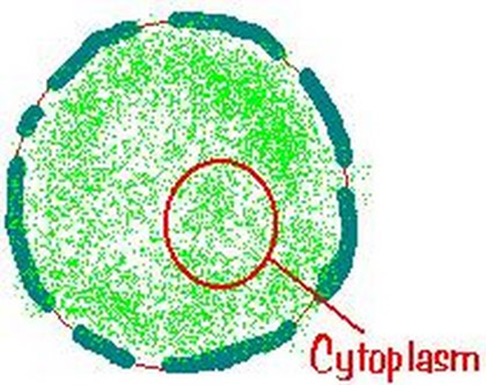
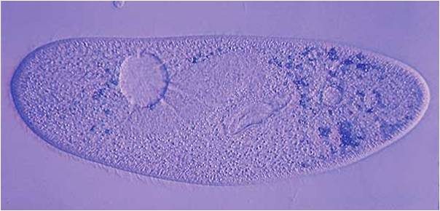
Organelles
Cytoplasm – a jellylike liquid inside the cell where other cell parts float. Nutrients are absorbed, transported, and processed within the cytoplasm.

Slide 26
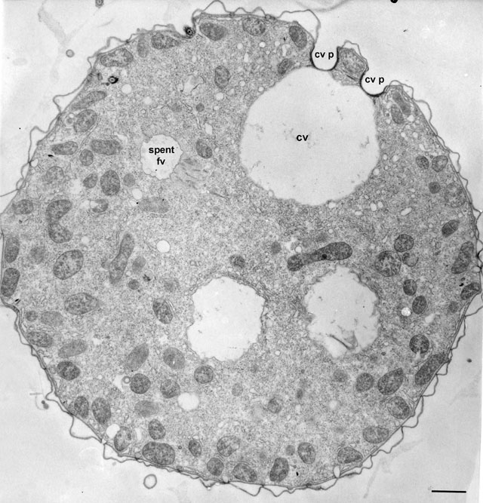
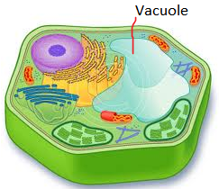
Vacuoles – Balloon-like spaces within the cytoplasm that are the storage places for surplus food, and other substances that the cell cannot use right away.

Slide 27
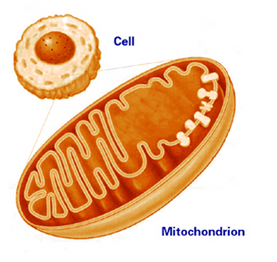
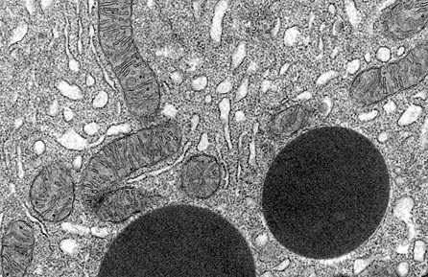
Mitochondria – Sausage shaped energy producing organelles in the cell. Some cells have more mitochondria than others because they need more energy.(ex. Muscle cells)

Slide 28
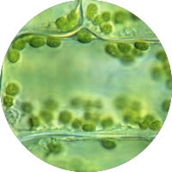
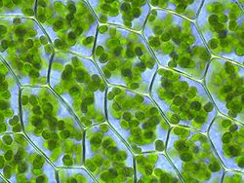
Chloroplasts –Oval shaped structures in which the process of photosynthesis takes place. Only found in green plants and some unicellular organisms. Chlorophyll is found in the chloroplasts.

Slide 29
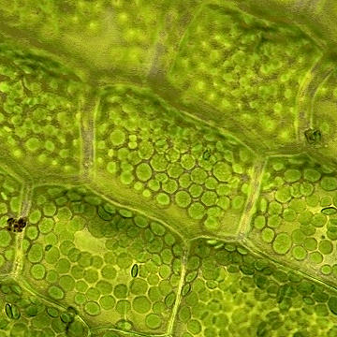
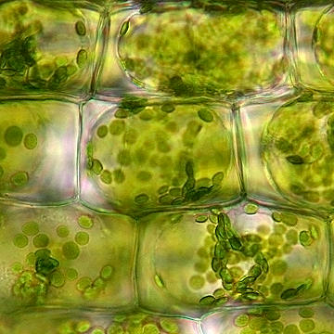
Cell Wall – occurs only in plants, fungi, and occasionally in some unicellular organisms. It is a rigid frame-like covering that surrounds the cell membrane and gives support and structure to the organism.

Slide 30
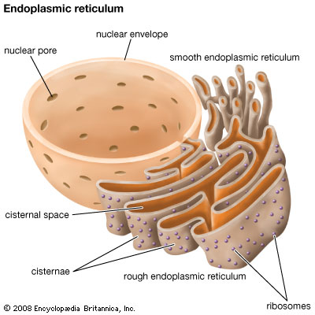
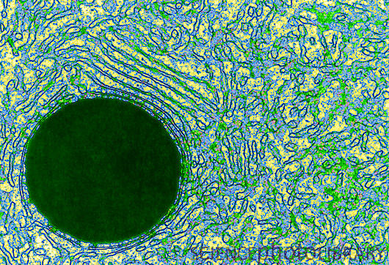
Endoplasmic Reticulum – This organelle is like a highway, where materials are transported through the cell or to the outside of the cell. The endoplasmic reticulum is a folded membrane.

Slide 31
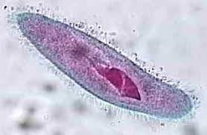
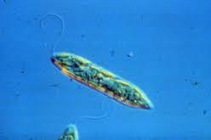
Movements
Outside the cell membrane, some cells have a flagellum which is a whip-like tail that assists with movement.
Some cells have many hair-like structures called cilia that help the cell move about its surroundings.
Euglena
Paramecium

