Slide 1
Elements, Compounds & Mixtures

Slide 2
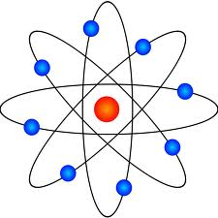
Elements
An element is a pure substance made of only 1 type of atoms.

Slide 3
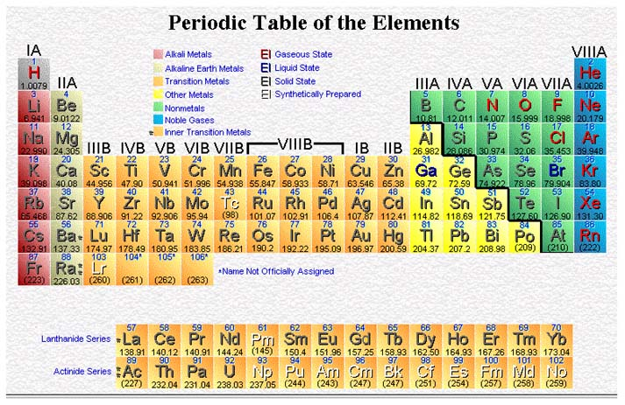

Slide 4
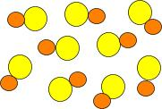
Compounds
A compound is a pure substance made of 2 or more elements that are chemically combined.

Slide 5
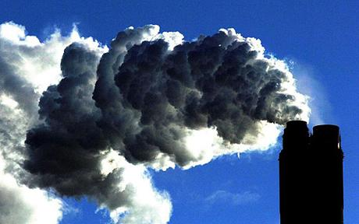
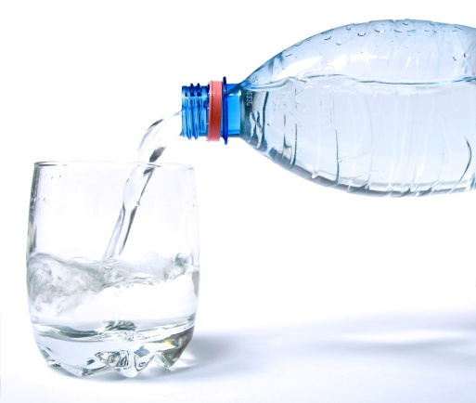
Examples of Compounds
Compounds contain elements
Properties of compounds are different from elements
Compounds CAN be separated by chemical means
Sodium (Na)
+
Chlorine (Cl)
NaCl
Hydrogen (H) + Oxygen (O)
H₂O
Carbon (C) + Oxygen (O)
CO₂

Slide 6
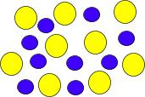
Mixtures
A mixture is a combination of 2 or more substances that are not chemically combined.

Slide 7
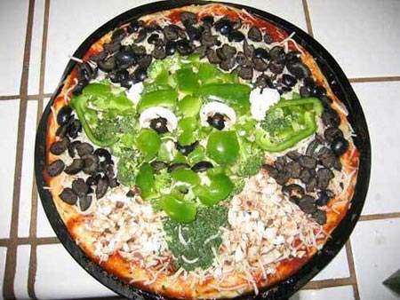
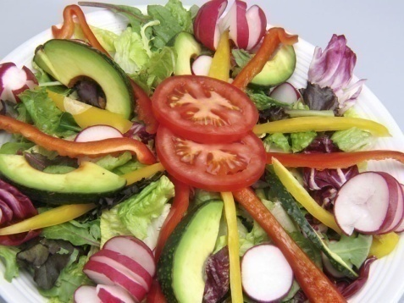
Examples of Mixtures
chicken noodle soup
salad
pizza – yes, that would be Yoda…
Properties of Mixtures:
Each substance in a mixture has its own property
Mixtures can be separated by physical means

Slide 8
Write whether each of the following is an ELEMENT, COMPOUND or MIXTURE

Slide 9
Write whether each of the following is an ELEMENT, COMPOUND or MIXTURE
CARBON DIOXIDE
NITROGEN
AMMONIA
OXYGEN
WATER (VAPOUR)
ARGON
AIR
HYDROGEN

Slide 10
Property | Metals | Non-Metals
Appearance | Shiny | Dull
Melting & boiling point | High. Except Hg is a liquid | Low. Except Br2 is a liquid
Density | High ( Feel Heavy) | Low (Feel Light)
Strength | Strong | Not Strong
Malleability | Malleable (Changed into sheets) | Not Malleable
Ductility | Ductile (Changed into wires) | Not Ductile
Heat Conductivity | Good | Poor
Electrical Conductivity | Good | Poor

Slide 11
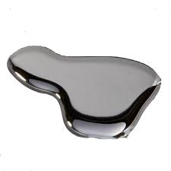
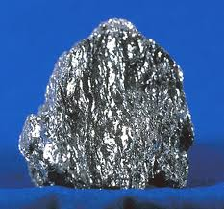
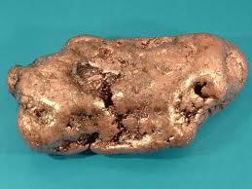
Metals: Copper (Cu), tin (Sn), lead (Pb), iron (Fe), gold (Au), mercury (Hg)

Slide 12
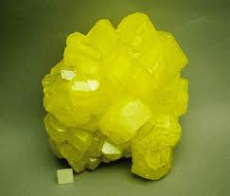
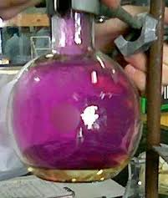
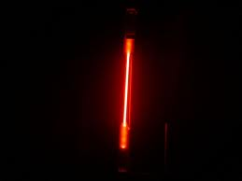
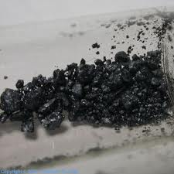
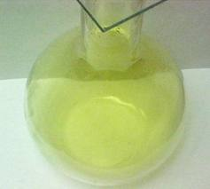
Nonmetals: sulfur (S), iodine (I), neon (Ne), chlorine (Cl), oxygen (O), hydrogen (H)

Slide 13
ALLOYS
Alloys are mixtures of ….
Metal + Metal
Metal + Nonmetal
They are usually more stronger than metals!!!

Slide 14
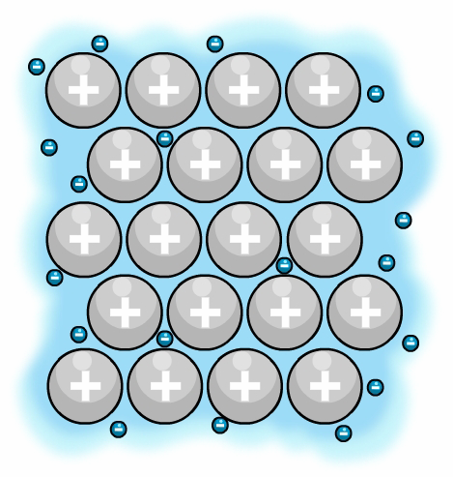
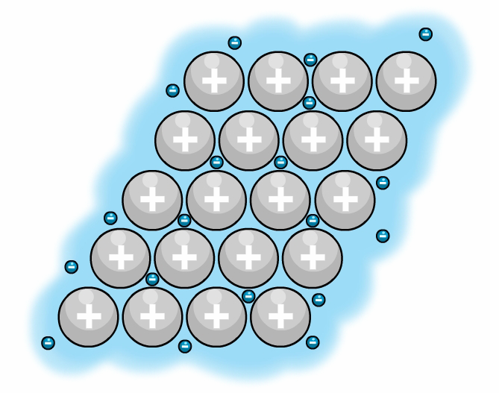
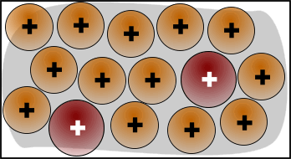
When you hit the metal, the layers can slide…..
Metal
force
But for alloys, when you hit, the layers cannot slide…..because the atoms are of different size!!
So More STRONG than metals
force

Slide 15
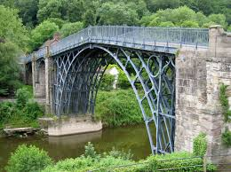
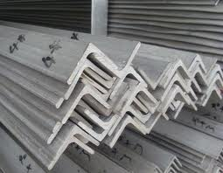
Examples of Alloys
Different types of steel
Steel = IRON + CARBON
= IRON + CARBON + Chromium / Nickel
= IRON + CARBON + Manganese

Slide 16
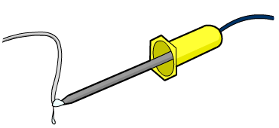
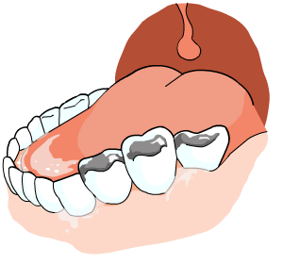
Brass = Copper + Zinc.
Bronze = Copper + Tin
Solder = Zinc + Lead
Amalgam = Mercury + Silver

Slide 17
Bonding
Every Atom wants to become stable - have a complete outer most shell.
To become stable; it can
Gain electrons
Loose electrons
An attraction between two or more atoms to become stable (have a complete outermost shell) is called a Chemical Bond.

Slide 18
Types of Bonds
Metallic Bond- metal+metal
Covalent Bond- nonmetal+nonmetal
Ionic Bond- nonmetal+metal

Slide 19
Bonding in Metals
=
METALLIC BONDING

Slide 20
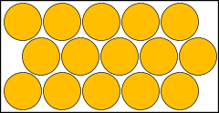
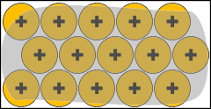
All metal atoms are arranged in a regular pattern – Metallic Lattice
Metal atoms have tendency to loose their outer into a “sea” of electrons to become stable.
Free / Delocalized Electrons / Sea of electrons
Cations

Slide 21
Having lost electrons, the atoms are no longer electrically neutral. They are metal cations= “Metallic Bonding.”

Slide 22
The metal structure is made up of positive ions packed together surrounded by a “sea” of free electrons.
Na
Na
Na
Na
Na
Na
Na
Na
Na
Na
Na
Na
Na
Na
Na
These delocalized electrons form a kind of electrostatic glue holding the structure together.
Metals can conduct electricity because of these mobile electrons being able to carry current.
Also present in alloys such as brass and solder.

Slide 23
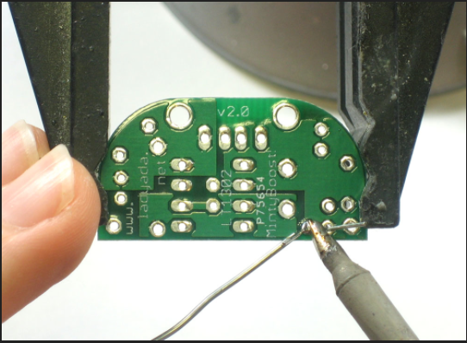
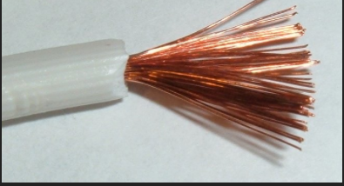
Solder
Brass

Slide 24
Bonding in Non-Metals
=
COVALENT BONDING

Slide 25
How can atoms become stable if they do not want to loose or gain electrons?
Covalent bond are found between the atoms in molecules by the sharing of a pair of electrons.
Molecules can be: SIMPLE MOLECULES H₂, CO₂, CH₄
Or GIANT MOLECULES diamond, graphite, silica

Slide 26
Remember diatomic molecules? (H₂, N₂, F₂, O₂, I₂, Cl₂, Br₂) They only come in pairs.
Many non-metallic elements form diatomic molecules other and the noble gases because they already have their 8 valence electrons.
Hence the halogens we learned about are diatomically held together by covalent bonds.
When drawing diagrams showing the overlap of the outer shells, we can show the outer electrons only, because the inner electrons are not involved in bonding.

Slide 27
Simple
Molecules
Both Hydrogen atoms needs 1 electron to complete its outer shell (become stable)
But any one of them will not give electron to the other!!!
H
H
So they will SHARE 1 PAIR of electrons to become stable!
Hence both atoms have noble gas configuration
This attraction between two atoms is called COVALENT BOND
H H
H H
PRESS THE SPACE BAR TO START / ADVANCE AN ANIMATION

Slide 28
Simple
Molecules
CHLORINE
Cl
Cl
Both Chlorine atom needs one electron to complete its outer shell
Atoms share a pair of electrons
Cl Cl
Cl Cl
PRESS THE SPACE BAR TO START / ADVANCE AN ANIMATION

Slide 29
Simple
Molecules
HYDROGEN CHLORIDE
Cl
H
Atoms share 1 pair of electrons
Both atoms need one electron to complete its outer shell
H Cl
H Cl
PRESS THE SPACE BAR TO START / ADVANCE AN ANIMATION

Slide 30
Simple
Molecules
METHANE
H
Each hydrogen atom needs 1 electron to complete its outer shell
H
H
C
H C H
H
H
H
H
A carbon atom needs 4 electrons to complete its outer shell
Carbon shares all 4 of its electrons to form 4 single covalent bonds
H C H
H
PRESS THE SPACE BAR TO START / ADVANCE AN ANIMATION

Slide 31
Simple
Molecules
AMMONIA
Lone pair
H
N
Each hydrogen atom needs one electron to complete its outer shell
H N H
H
H
H
H N H
Nitrogen can only share 3 of its 5 electrons otherwise it will exceed the maximum of 8
So 2 electrons REMAINS!
Nitrogen atom needs 3 electrons to complete its outer shell
H
PRESS THE SPACE BAR TO START / ADVANCE AN ANIMATION

Slide 32
Simple
Molecules
WATER
Each hydrogen atom needs one electron to complete its outer shell
H
O
H O
H
H
Oxygen atom needs 2 electrons to complete its outer shell
Oxygen can only share 2 of its 6 electrons otherwise it will exceed the maximum of 8
2 LONE PAIRS REMAIN
H O
H
PRESS THE SPACE BAR TO START / ADVANCE AN ANIMATION

Slide 33
Simple
Molecules
OXYGEN
O
O
O
O
each oxygen atom needs two electrons to complete its outer shell
each oxygen shares 2 of its electrons (4 electrons = 2 Pairs) to form a
DOUBLE COVALENT BOND
O O
O₂

Slide 34
Giant
Molecules
GIANT MOLECULAR STRUCTURES
Diamond
Graphite
Silicon Dioxide
Joined by an extensive network, lattice. All held together by single covalent bonds.

Slide 35
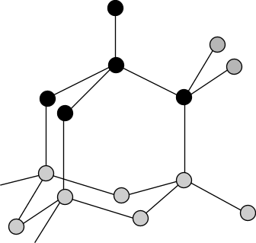
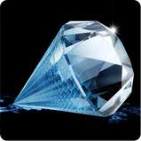
Giant
Molecules
Diamond
Each C atom is joined to 4 other C atoms in a giant lattice

Slide 36
Giant
Molecules
Diamond
Many bonds must be broken to separate all C atoms. Hence MELTING POINT is very high and it is VERY STRONG

Slide 37
Giant
Molecules
Diamond
All 4 electrons of C are used in bonding. So No free electrons . So, DO NOT CONDUCT ELECTRICITY!

Slide 38
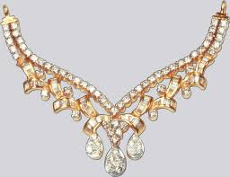
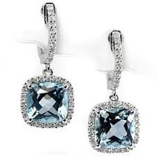
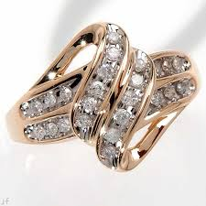
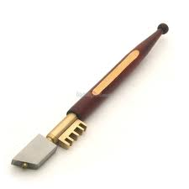
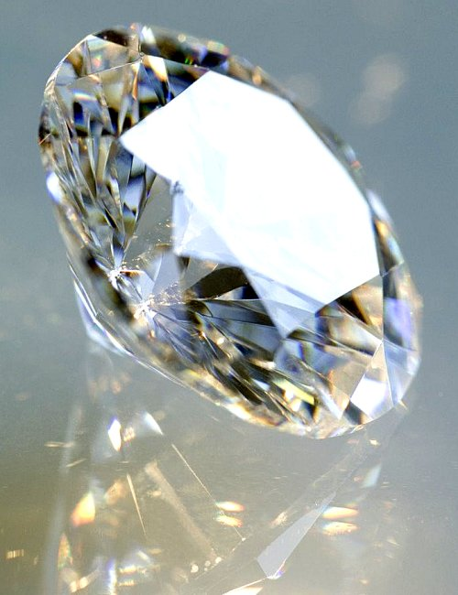
Giant
Molecules
Uses of Diamond
Used in Jewelry
Used in cutting glass and rocks (Drilling

Slide 39
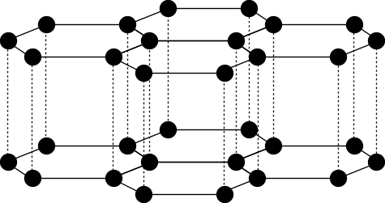
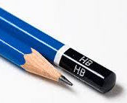
Giant
Molecules
Graphite
Each carbon atom is joined to 3 other Carbon atoms in one layer of the giant lattice
So many bonds must be broken to separate. Hence MELTING POINT is very high

Slide 40
Giant
Molecules
Graphite
The force of attraction between two layers is very weak. So it is SOFT

Slide 41
Giant
Molecules
Graphite
Only 3 electrons of Carbon are used for bonding. So the 4rth electron of every carbon is free to move. Hence it CONDUCTS ELECTRICITY!

Slide 42
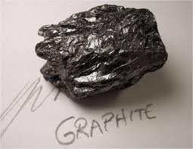
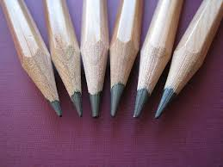
Giant
Molecules
Graphite
The layers can slide over each other – So being soft - used as a
Lubricant
Pencils

Slide 43
Giant
Molecules
Silica/ Silicon (IV) Oxide/ Silicon Dioxide/ Quartz
Each Si atom is joined to 4 O atoms &
Each O atom is joined to two Si atoms
silicon atoms
oxygen atoms

Slide 44
Giant
Molecules
Silica/ Silicon (IV) Oxide/ Silicon Dioxide/ Quartz
All bonds between Si & O atoms are Covalent Bonds.
So many bonds must be broken to separate.
Hence MELTING POINT is very high and it is STRONG
silicon atoms
oxygen atoms

Slide 45
Giant
Molecules
Silica/ Silicon (IV) Oxide/ Silicon Dioxide/ Quartz
All electrons of Si and O are used in bonding. So no free electrons.
Hence, DO NOT CONDUCT ELECTRICITY.
silicon atoms
oxygen atoms

Slide 46
Giant
Molecules
Property | Diamond | Graphite | Silicon Dioxide
M.p and B.p
Hardness
Conducting electricity
Conducting heat

Slide 47
Giant
Molecules
Property | Diamond | Graphite | Silicon Dioxide
M.p and B.p | Very high | Very high | Very high
Hardness | Hard | Soft (so used as lubricant) | Hard
Conducting electricity | No | Yes | No
Conducting heat | No | yes | no

Slide 48
Bonding in Non-Metal + Metals
=
IONIC BONDING

Slide 49
Ionic bond exists between ions
Positive Ions
Negative Ions
Held together by electrostatic forces.
Losing of e → Positive Ion = Cation
Gaining of e → Negative Ion = Anion

Slide 50
SODIUM CHLORIDE
Na
Cl
SODIUM ATOM
2,8,1
CHLORINE ATOM
2,8,7
PRESS THE SPACE BAR TO START / ADVANCE AN ANIMATION

Slide 51
SODIUM CHLORIDE
+
Na
Cl
SODIUM ION
2,8
CHLORIDE ION
2,8,8
Cation
Anion
both atomic species now have ‘full’ outer shells; They have a Noble Gas Configuration

Slide 52
CALCIUM CHLORIDE
Cl
Ca
CHLORINE ATOMS
2,8,7
Cl
CALCIUM ATOM
2,8,8,2
PRESS THE SPACE BAR TO START / ADVANCE AN ANIMATION

Slide 53
CALCIUM CHLORIDE
Cl
2+
Ca
CHLORIDE IONS
2,8,8
Cl
CALCIUM ION
2,8,8
PRESS THE SPACE BAR TO START / ADVANCE AN ANIMATION

Slide 54
MAGNESIUM OXIDE
Mg
O
MAGNESIUM ATOM
2,8,2
OXYGEN ATOM
2,6
PRESS THE SPACE BAR TO START / ADVANCE AN ANIMATION

Slide 55
MAGNESIUM OXIDE
Mg²⁺
O²⁻
MAGNESIUM ION
2,8
OXIDE ION
2,8
PRESS THE SPACE BAR TO START / ADVANCE AN ANIMATION

Slide 56
Lewis Structures (drawing ionic bonds)

Slide 57
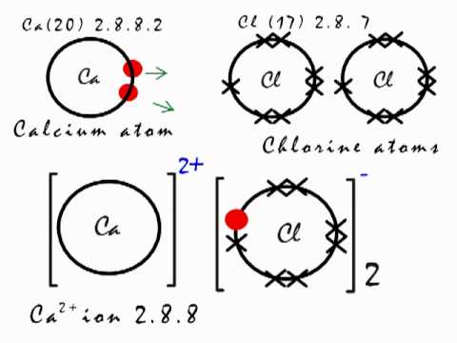

Slide 58
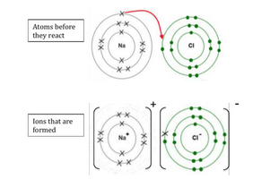
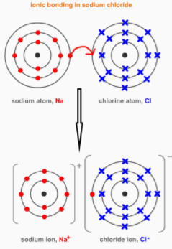

Slide 59
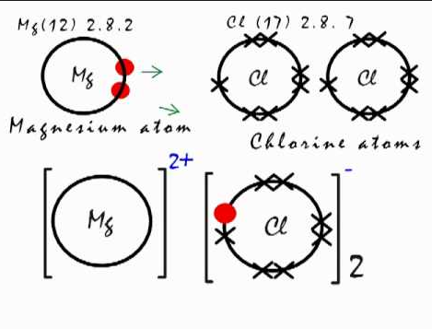

Slide 60
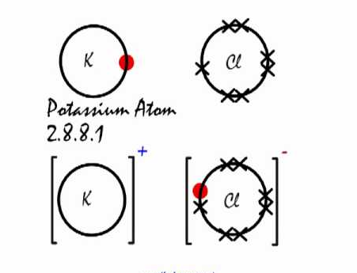

Slide 61
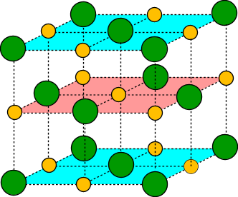
IONIC BONDING IN SODIUM CHLORIDE
Cl⁻ chloride ion
Na⁺ sodium ion

Slide 62
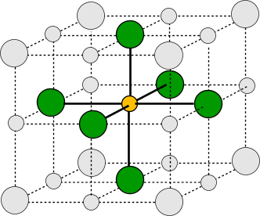
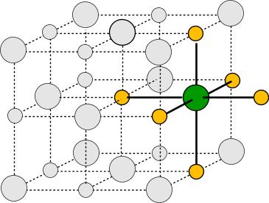
IF YOU SEE INSIDE …………….
Cl⁻ Chloride ion Na⁺ Sodium ion
1 Sodium Ion is SURROUNDED by 6 Chloride Ions
1 Chloride Ion is SURROUNDED by 6 Sodium Ions

Slide 63
IONIC BONDING IN SODIUM CHLORIDE
Cl⁻ chloride ion
Na⁺ sodium ion
All the ions attract each other by STRONG ELECTROSTATIC FORCES in all directions

Slide 64
IONIC BONDING IN SODIUM CHLORIDE
Cl⁻ chloride ion
Na⁺ sodium ion
So there is no SINGLE Molecule of NaCl, just a big structure with same number of Na and Cl Ions – Called IONIC LATTICE
YOU DO NOT GET MOLECULES OF SODIUM CHLORIDE

Slide 65
Simple
Molecules
Property | Ionic Compounds | Covalent Compounds
Solubility | Soluble in Water | Not Soluble in Water
Conductivity | In Solid state: Do not Conduct In Molten or when dissolved in water: Conduct | Do no conduct Electricity
M.P and B.P | Usually very high | Usually low
 | They are Brittle

