Slide 1
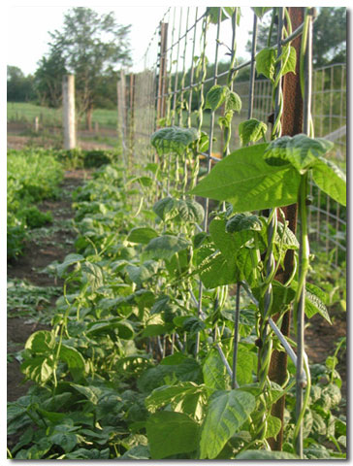
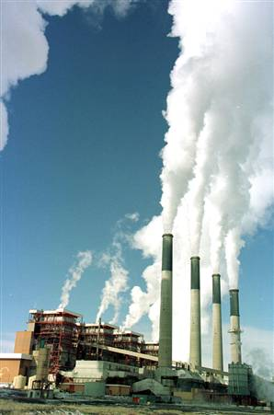
Cycles of Matter

Slide 2
The Water Cycle
The continuous process by which water moves from the Earth’s surface to the atmosphere and back.
It uses the process of:
Evaporation (liquid to gas)
Condensation (gas to liquid)
Precipitation (water vapor falls to Earth)

Slide 3
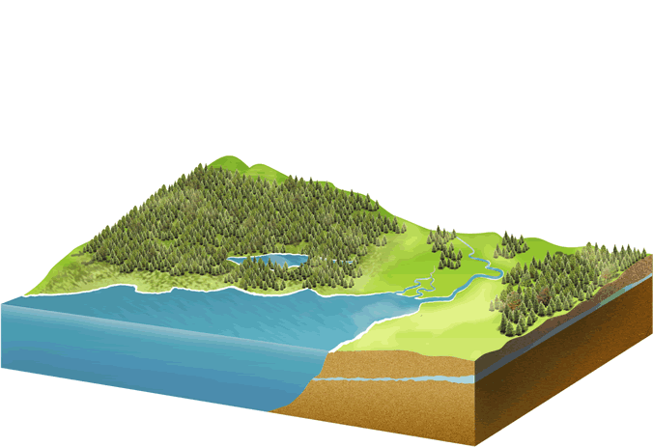
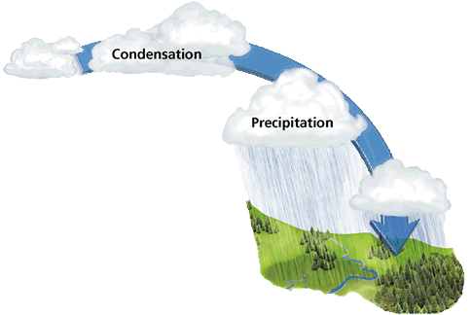
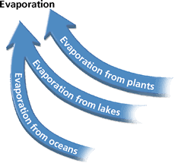
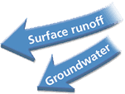

Slide 5
The Carbon & Oxygen Cycles
Carbon and oxygen are recycled.
Producers, consumers and decomposers all play a role in this cycle.
6CO₂ + 6 H₂O C₆H₁₂O₆ + 6 O₂
Plants and Consumers are dependent on each other!

Slide 9
The Carbon Cycle
Producers take in carbon dioxide and give off oxygen. (consumers are opposite).
Consumers eat producers (taking in carbon-food molecules) and release them as carbon dioxide and carbon waste products.
Decomposers break down the remains of producers and consumers and return it to the soil. They also release carbon dioxide.
https://www.youtube.com/watch?v=CLqFUI2Pvlc

Slide 11
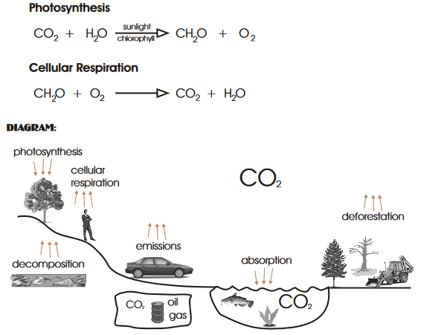

Slide 14
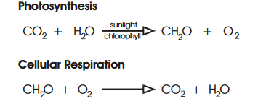
The Oxygen Cycle
Producers take in carbon dioxide and give off oxygen. (consumers are opposite)
Most organisms take in oxygen and give off carbon dioxide.
https://www.youtube.com/watch?v=E8Y6L5TI_94
Hilarious Video: https://www.youtube.com/watch?v=bWaEB4BMFAQ

Slide 15
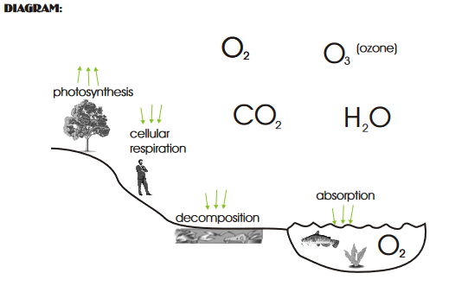

Slide 16
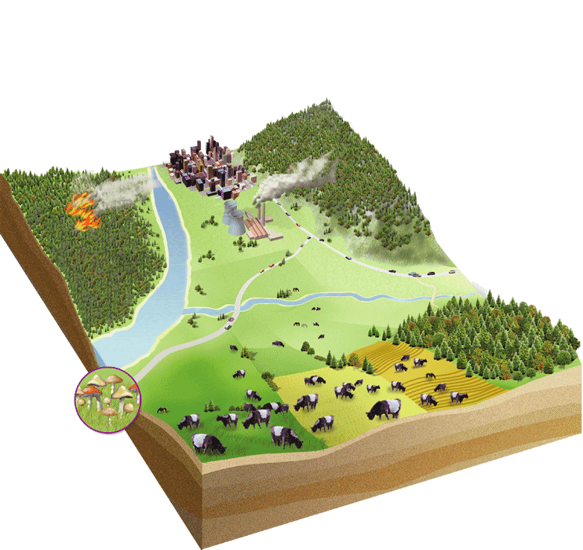
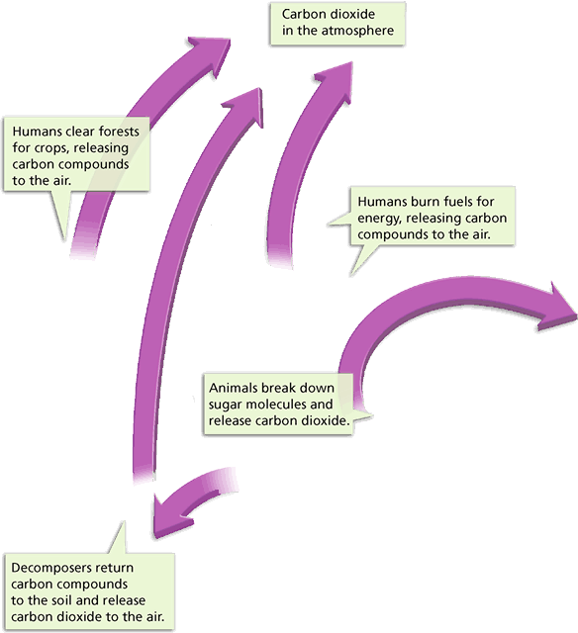
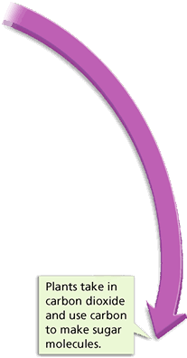
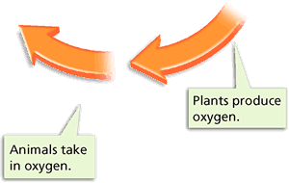
Carbon (purple) and Oxygen (orange) Cycle

Slide 17
The Human Impact
Humans affect the amount of carbon dioxide in the atmosphere:
Burning oil and other fossil fuels
Clearing forests for lumber
Burning down trees to clear a forest
Factories give off carbon dioxide

Slide 19
The Nitrogen Cycle
Nitrogen moves from the air to the soil, into living things, and back into the air.
Nitrogen gas is plentiful in the atmosphere (78%) but cannot be used until it is “fixed”.
Most nitrogen is fixed by bacteria.
They change free N to useable N.

Slide 20
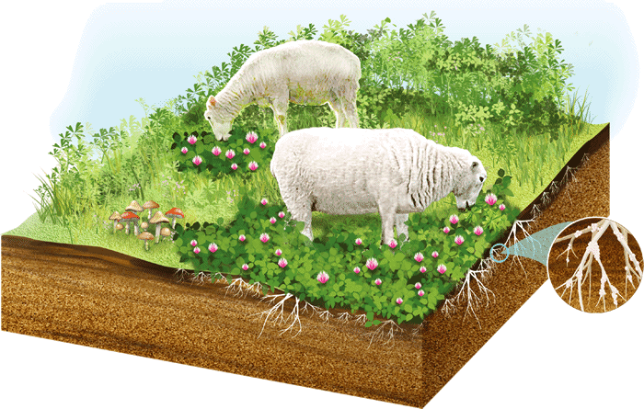
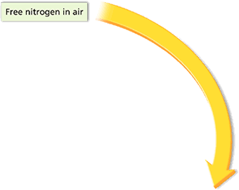
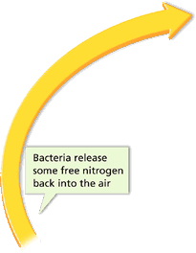
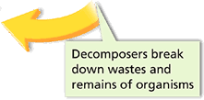
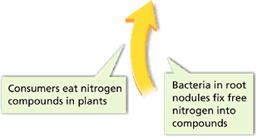

Slide 21
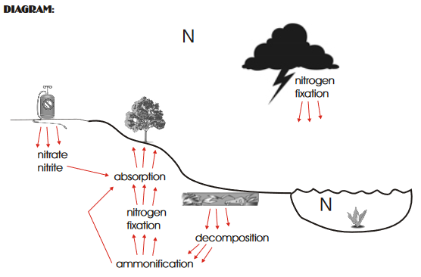

Slide 24
The Nitrogen Cycle
Fixation: The conversion of atmospheric nitrogen into nitrogenous compounds by bacteria (Rhizobia) found in the root nodules of legumes and certain other plants, and in the soil.
Nitrogen gas must be converted to form compounds such as ammonia (NH4) or nitrate (NO3) which can be taken up by living things
There is natural and human fixation of N2Natural: lightning, bacteria
Human: fossil fuel combustion, fertilizer manufacturing
Assimilation: Plants take nitrogen from the soil, by absorption through their roots in the form of their nitrate ions or ammonium ions. All nitrogen obtained by animals can be traced back to the eating of plants.

Slide 25
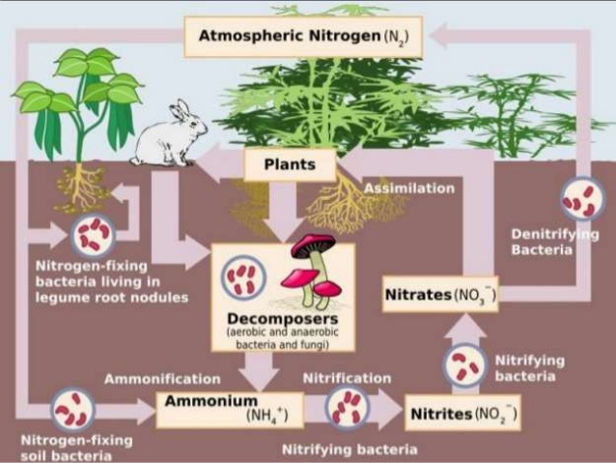
The Nitrogen Cycle
Denitrification: Process occurs when nitrates (NO3-) reduced to gaseous nitrogen (N2), as by bacterial action on soil.

Slide 26
The Release of Nitrogen
Producers use Nitrogen to build proteins and other compounds.
Decomposers can break down waste (including animal waste) and return it to the atmosphere.
Nitrogen fixing bacteria can live on the roots of legumes, such as peanuts and beans.
https://www.youtube.com/watch?v=K5EOZenSSB8

Slide 28
The Nitrogen Cycle
Ammonification: When a plant or animal dies, or an animal expels waste, the initial form of nitrogen is organic. Bacteria, or fungi in some cases, convert the organic Nitrogen within the remains back into Ammonium (NH4+).
Nitrification: The oxidation of the Ammonium compounds in dead organic material into nitrites and nitrates by soil nitrobacteria, making Nitrogen available to plants.
Nitrosamine species converts ammonia to nitrites (NO2).
Nitrobacteria species are responsible for the oxidation of the nitrites into nitrates (NO 3-).

Slide 30
This is happening in Lake Erie! One of Canada’s great lakes! You can not swim in it because “blue algae” is dangerous and can cause illness.

Slide 31
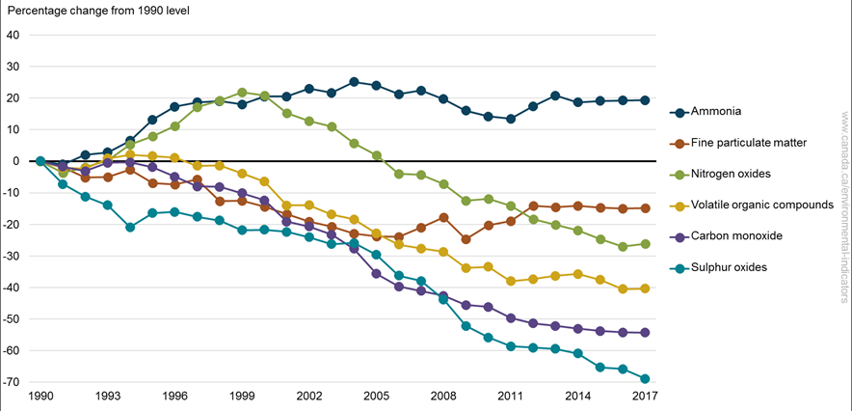
Human Impact
Last 100 years: humans have more than doubled the amount of fixed nitrogen that is pumped into the atmosphere every year.
Consequences: acid rain, creation of ground level ozone, groundwater contamination, and eutrophication

Slide 33
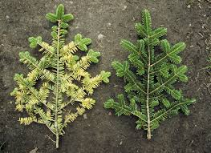
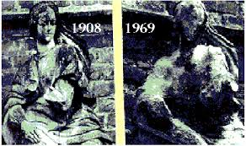
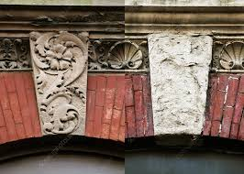
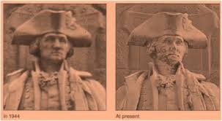
Acid Rain

Slide 34
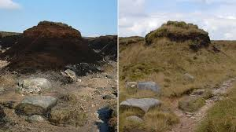
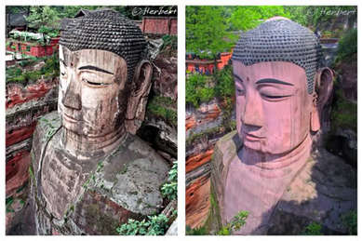
Buddah of Leshan (cultural significance 1300 years old)
Landforms and vegetation

Slide 35
The Phosphorus and Sulphur Cycle
Phosphorus is an essential element to all life. It is an important part of the ATP molecule that stores and gives every cell its energy. It is also found in DNA and RNA, which tell the cells how to look and act. Needless to say, phosphorus is needed for every living organism to grow and function
https://www.youtube.com/watch?v=CeH-f-cmCkc

Slide 36
Phosphorus Cycle
How Phosphorus Cycle works?
1. Phosphate is released by the erosion of rocks.
2. Plants and fungi take up the phosphate with their roots.
3. Phosphorus moves from producers to consumers via food chain.
4. Phosphorus may seep into groundwater from soil, over time forming into rock.
5. When these rocks erode, the cycle begins again

Slide 37
Phosphorus Cycle

Slide 38
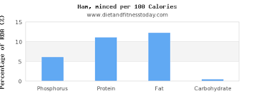
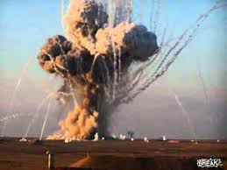
White Phosphorus is used in some explosives, including rockets. This caused an uproar because of safety concerns.
Red Phosphorus is used in match heads. You can see the texture of a match head next to the matches. E.G. Computer, Smartphones, Televisions and Cars, Housing Complexes and Wiring, Bread, Ham and Sausages, Soft Drinks, Plants, The Body.

Slide 39
Too much? Too little?
Negative Effects
Too much phosphate can cause health problems, such as kidney damage and osteoporosis.
Phosphate shortages can also occur in our bodies. These are caused by extensive use of medicine.
White phosphorus can cause skin burns. While burning, white phosphorus may cause damage to the liver, the heart or the kidneys.
Somethings we have seen/heard before!!!!!!!!!!!!!
EUTROPHICATION the process by which a body of water becomes enriched in dissolved nutrients (as phosphates) that stimulate the growth of aquatic plant life usually resulting in the depletion of dissolved oxygen.

Slide 40
This is happening in Lake Erie! One of Canada’s great lakes! You can not swim in it because “blue algae” is dangerous and can cause illness.

Slide 41
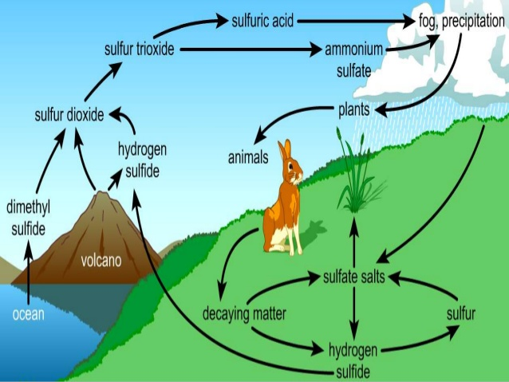
The Sulphur Cycle
https://www.youtube.com/watch?v=CeH-f-cmCkc

Slide 42
The Sulphur Cycle
is the collection of processes by which sulfur moves to and from minerals (including the waterways) and living systems.
Such biogeochemical cycles are important in geology because they affect many minerals. Biogeochemical cycle, substance turnover or cycling of substances is a pathway by which a chemical element or molecule moves through both biotic (biosphere) and abiotic (lithosphere, atmosphere, and hydrosphere) compartments of Earth.

Slide 43
How Sulphur Cycle works?
It includes both atmospheric and terrestrial processes.
1.Hydrogen Sulfide (H2S) is released into the atmosphere (volcanic eruptions, fossil fuel burning, and the anaerobic decay of sulfur-containing biological material in swamps, bogs)
2.Certain marine algae dimethyl sulfide + Oxygen in atmosphere = Sulfur dioxide.
3.Volcanic eruptions Sulfur dioxide
4.Burning of fossil fuels Sulfur dioxide
5.Sulfur dioxide + Oxygen = Sulfur trioxide, then reacts with tiny water droplets = Sulfuric Acid
6.Sulfur Oxides reacts with Ammonia = tiny particles of ammonium salts.
7.Wind carries Sulfuric acid and ammonium salts which falls to earth in form of pecipitation.

Slide 44
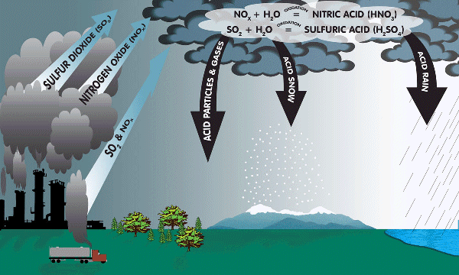
Acid rain AGAIN
Acid Rain
1.Burning of fossil fuels from factories and automobiles releases SO2 into the atmosphere
2. SO2 combines with water in clouds which creates acid rain (H2 SO4)3. Acid rain slowly erodes structures, both natural and man made

Slide 45
RECAP VIDEO!
https://www.youtube.com/watch?v=Bn41lXKyVWQ

