Slide 1
Protein Synthesis
How DNA directs how proteins are made

Slide 2
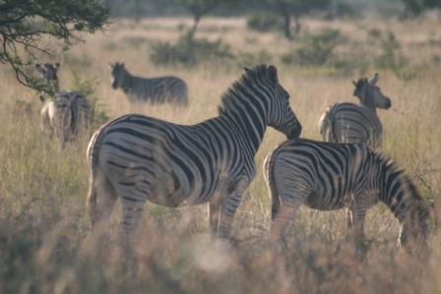
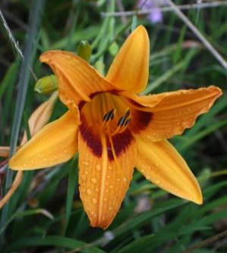
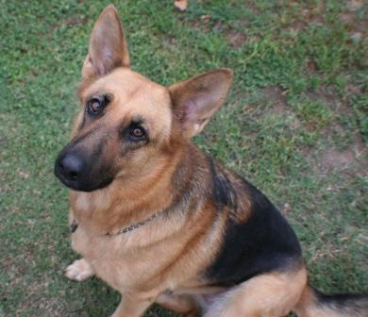
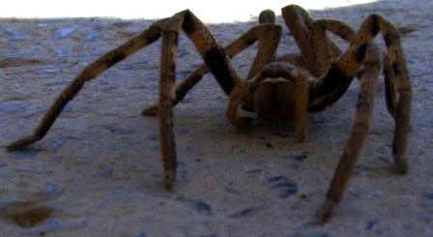
The variety of life on earth is due to different proteins.

Slide 3
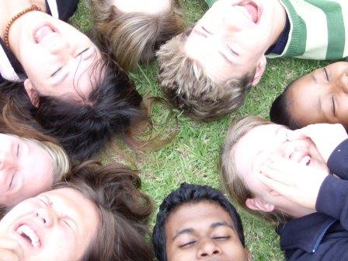
Protein Synthesis
You are different from the people around you because your proteins are different.

Slide 4
From Genes to Proteins
DNA molecules in a chromosome are organized into genes.
RNA is a copy of the genetic information in the gene
  RNA carries instructions for making proteins from genes in nucleus to ribosomes in cytoplasm

Slide 5
Why are Proteins Important?

Slide 6
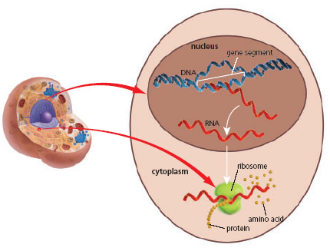
Protein Synthesis

Slide 7
Protein Synthesis
Only certain genes are ACTIVATED in a cell
Depending which genes are active, different proteins are produced, and this causes cells to have different functions.
E.x. You do not have skin pigment genes being used by your stomach cells
ONE GENE →ONE TYPE OF PROTEIN →ONE FUNCTION

Slide 8
There are several steps to making a protein from DNA, AKA Protein Synthesis.
1. Nucleus receives a signal to make a specific protein.
2. The DNA message for a specific protein is copied into a small molecule called ribonucleic acid (RNA). The RNA has only one strand.
3. RNA leaves through a nuclear pore
4. The RNA message is delivered to the ribosome, and the ribosome makes the protein.
5. The manufactured protein enters the ER.
6. A vesicle forms off the end of the ER and carries the protein to the Golgi body

Slide 9
7. The Golgi body repackages the protein for transport out of the cell.
8. A vesicle forms off the end of the Golgi body to carry the protein to the cell membrane.
9. The vesicle attaches to the cell membrane and its protein contents are released out of the cell

Slide 10
TRANSCRIPTION
A piece of DNA that codes for a protein is copied into mRNA

Slide 11
Protein Synthesis
Act One: TRANSCRIPTION(Trans= across, cription= to write)
The coded message of a gene on DNA has INSTRUCTIONS on how to make particularPROTEINS that our bodies need.
The instructions from a gene are copied from DNA to MESSANGER RIBONUCLEIC ACID(MRNA)in the nucleus.

Slide 12
RNA has slightly different bases: A, G, C and URACIL instead of thymine
•Once complete, the mRNA moves through the NUCLEAR PORES and into the cytoplasm where the proteins are made.
•The process of making mRNA is called TRANSCRIPTION

Slide 13
Watch the General Process
•Step 1: UNZIPPING of the DNA from a double strand into two single strands
•Step 2: RIBOSOMAL BASES pair up with the bases on one of the DNA strands to form mRNA
•Step 3: ENZYMES help form the RNA BACK BONE and checks for ERRORS
•Step 4: The MRNA is released, leaves the nucleus, & the DNA ZIPS BACK UP

Slide 14
TRANSCRIPTION
Part of the DNA molecule is unzipped by an enzyme

Slide 15
TRANSCRIPTION
DNA separates

Slide 16
TRANSCRIPTION
T
A
A
U
A piece of DNA from one side is copied into mRNA
C
G
A
U
A
U
A
U
A
U
G
C
C
G
G
C
G
C
T
A

Slide 17
TRANSCRIPTION
mRNA separates from DNA
T
A
A
U
C
G
A
U
A
U
A
U
A
U
G
U
U
U
U
C
G
C
C
A
A
U
G
C
C
G
G
C
G
C
T
A

Slide 18
T
A
C
A
A
A
A
U
G
U
U
U
U
C
G
C
C
A
A
G
C
G
G
T

Slide 19
mRNA moves out of the nucleus to a ribosome in the cytoplasm
T
A
C
A
A
A
A
U
G
U
U
U
U
C
G
C
C
A
A
G
C
G
ribosome
G
T

Slide 20
TRANSLATION
The ribosome encodes mRNA to form a new protein

Slide 21
Act Two:TRANSLATION
The mRNA moves into the cytoplasm and pairs up with a RIBOSOME. It is here that the mRNA will be “read” to make a protein.
The mRNA code is made up of groups of TRIPLET_CODESknown as CODONS.Each codon codes for a specific AMINO ACID.
Eg. AGC = Serine Eg. UGC = Cysteine

Slide 22
It takes 3_bases to make one codon. Why? Because there are about 20amino acids and we only have 3 BASES in the alphabet.
  With a _SINGLE_ nucleotide, there are only 4possible codes (41).
  For _DOUBLE_ nucleotides, there are only 16possible codes (42).
  However, for _TRIPLET_ nucleotides there are 64possible codes (43)

Slide 23
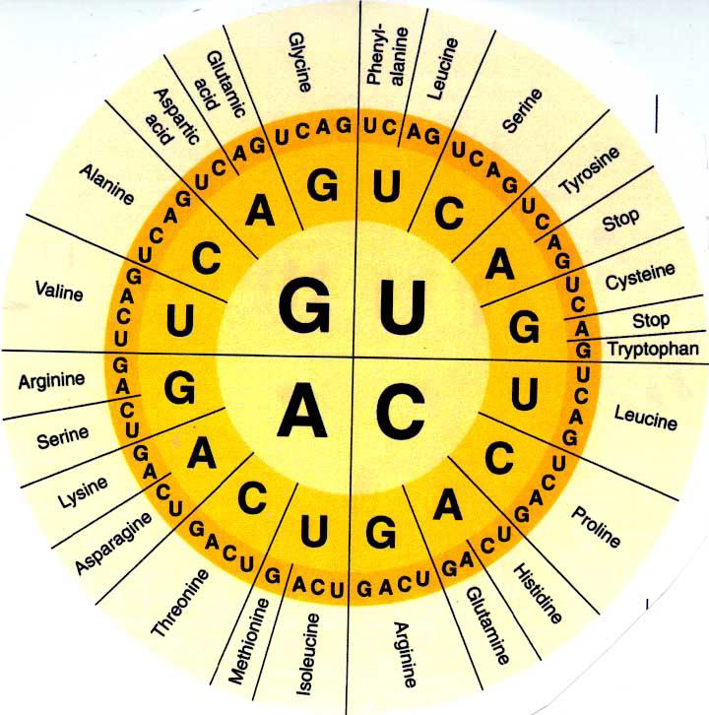
The amino acid for each codon is given in the tables below:
Now you try. What is the amino acid for each of the following codons?
CAU: ____________
AUG: ____________
CAU: ____________
UGA: ____________
GCC: ____________ AAA: ____________

Slide 24
During translation, the written code (codons) on mRNA is ‘TRANSLATED’ into a specific amino acid sequence by TRANSFER RIBONUCLUEIC ACID (tRNA) in the cytoplasm.
•A tRNA molecule is a small piece of RNA that has an AMINO ACID attached to it.
•The tRNA also has a special sequence of 3 bases known as an ANTICODON.
•There is at least one type of tRNA for each of the 20 amino acids.

Slide 25
As the correct AMINO ACIDS are brought to the ribosome by the tRNAs, they are joined together to form the PROTEIN CHAIN that the original DNA coded for.
Eventually, the finished protein chain moves to the GOLGIBODY, where it is packaged and released to do its “job”.

Slide 26
Describe what happens at each step:
______________________________________________________________________________________
_____________________________________________________________________________________
_____________________________________________________________________________________
_____________________________________________________________________________________
_____________________________________________________________________________________
_____________________________________________________________________________________
_____________________________________________________________________________________
_____________________________________________________________________________________
_____________________________________________________________________________________

Slide 27
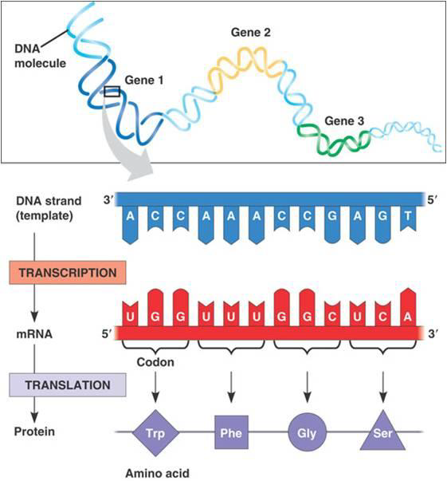
Worksheet:
DNA AND PROTEIN SYNTHESIS

Slide 28
MUTATIONS

Slide 29
Real or Fake?

Slide 30
A BAD NIGHT AT THE THEATRE
Question: What if something goes wrong during translation?
Answer: IF TRANSLATION IS ALTERED, THE PROTIEN PRODUCT WILL BE DIFFERENT
PROTEIN FUNCITON DEPENDS ON SHAPE! IF THE SHAPE CHANGES, IT’S FUNCTION CHANGES TOO!
Mutations can CHANGE in the base sequence of DNA
When the BASES(‘letters’) change, the INSTRUCTIONS used to make the protein also change.
Different AMINO ACIDS will be used, resulting in a different protein. This may alter protein shape, and also change or “break” protein function.

Slide 31
Genes and Variation
Genes are responsible for all the characteristics in a species
All members of the same species have the same number and types of genes (E.g. eye colour) but within a species we can have different versions of the same gene (E.g. blue vs brown)
Versions are called traits or alleles.

Slide 32
Changes to a Cell’s DNA

Slide 33
Changes to a Cell’s DNA
Any change in the DNA of a cell is called a gene mutation.
a change in the order of bases (A,C,T,G) that make up the gene.
There are several types of gene mutations from last year in Science 9:
  Deletion (base missing)
  Addition (extra base added)
  Substitution (one base substituted for another)

Slide 34
There are 2 types of MUTATION:
1. CHROMOSOMAL mutations: a mutation of all or part of a chromosome.
  This usually involves LARGE SEGMENTS OF DNA, and therefore, CAN HAVE GREATER IMPACT THAN SMALLER GENE MUTATIONS .
  There are four types of chromosomal mutations that involve part of the chromosome:

Slide 35
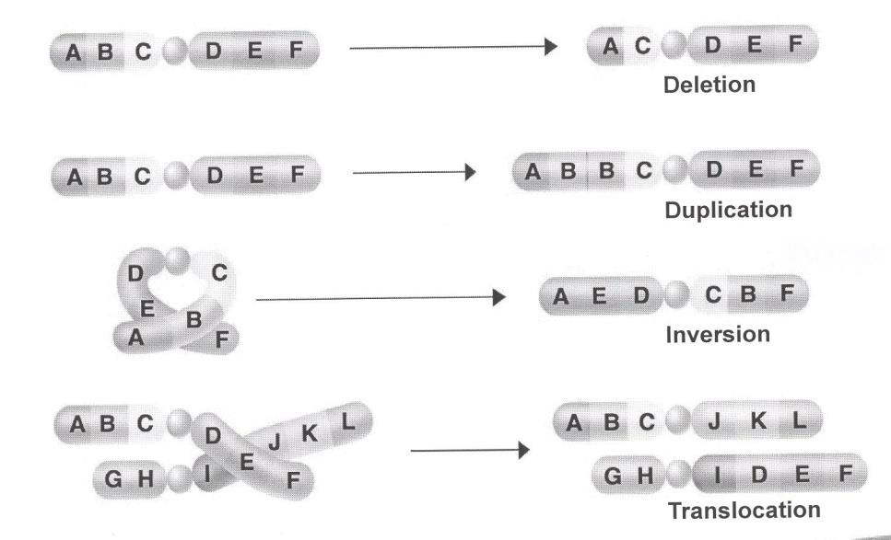
Chromosomal Mutations…

Slide 36
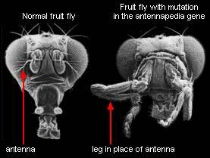
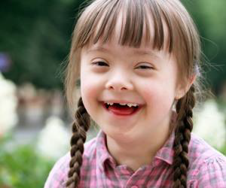
E.g. Fruit fly with legs in place of antennae. This mutation involves moving a controller gene telling the fruit fly where to put the legs
E.g. Down’s syndrome. This is a genetic disorder where there is an extra chromosome #21. The extra chromosome resulted from improper cell division.

Slide 37
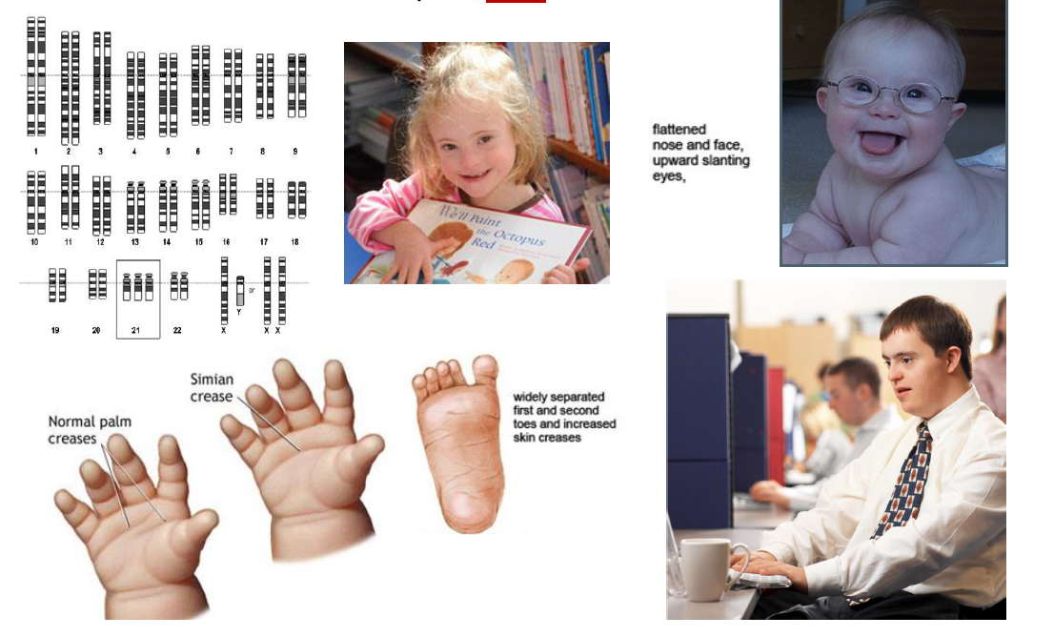
Examples: Down’ssyndrome –(Trisomy 21) 47chromosomes, extra chromosome at pair #21

Slide 38
The second Type!
2. GENE mutations: a mutation that occurs within a gene at some point along a chromosome. This mutation is only a change of one or a few ‘letters’ (bases).
  It usually only affects ONE GENE, and therefore, CAN HAVE LESS IMPACT THAN LARGER CHROMOSOMAL MUTATIONS.

Slide 39
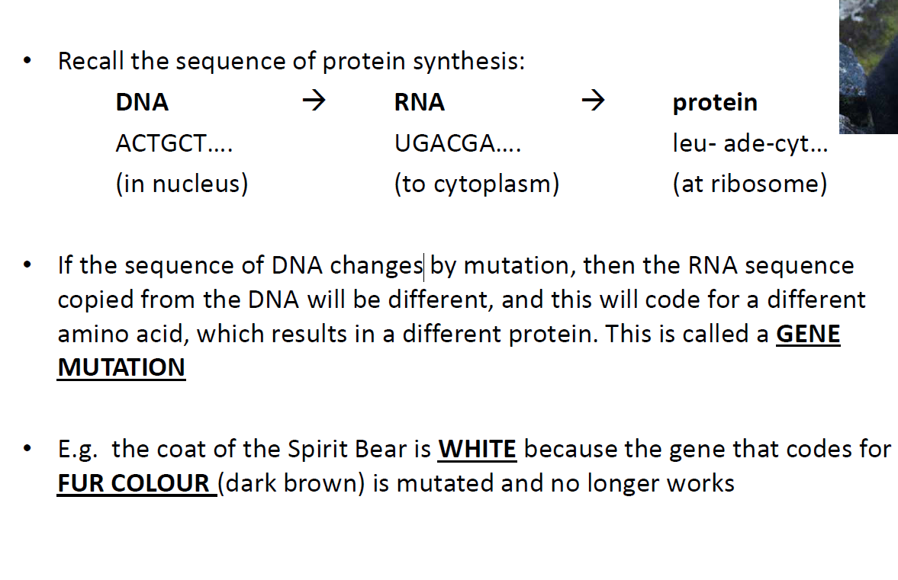
Gene Mutations (the ones from Grade 9!)

Slide 40
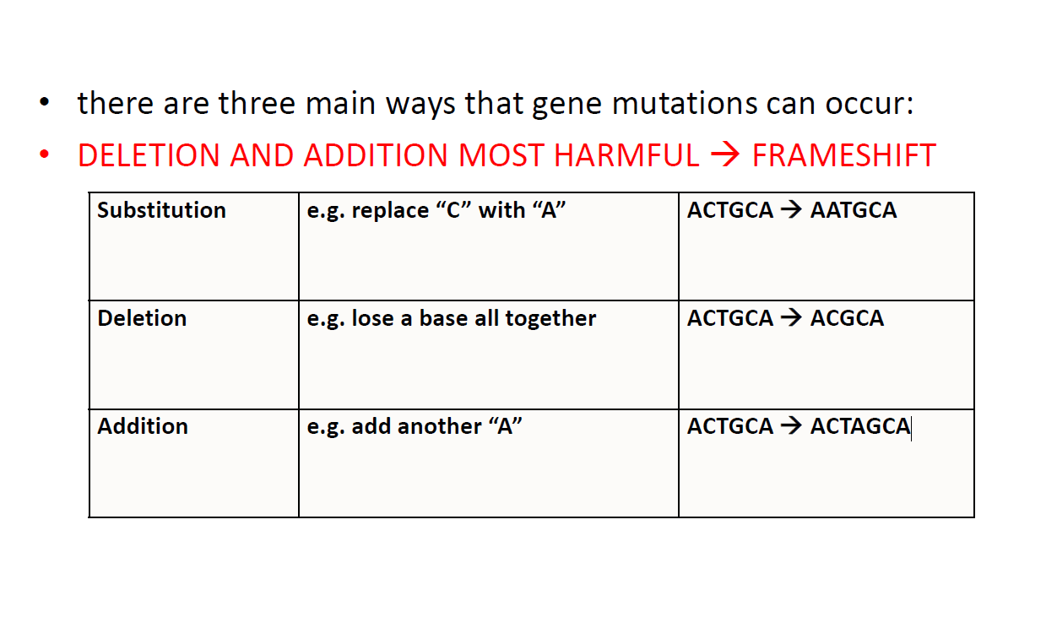

Slide 41
Types of Gene Mutations
mutations are often a bad thing because the protein does not work and your body needs it to function. These are known as NEGATIVE MUTATIONS and they DECREASE survival rates.
e.g. mutated gene
  SICKLE-CELL ANEMIA(misshapen red blood cells that don’t carry O2).
e.g. more than 1300 different mutations in one gene
  CYSTIC FIBROSIS(build up of mucus in the lungs)

Slide 42
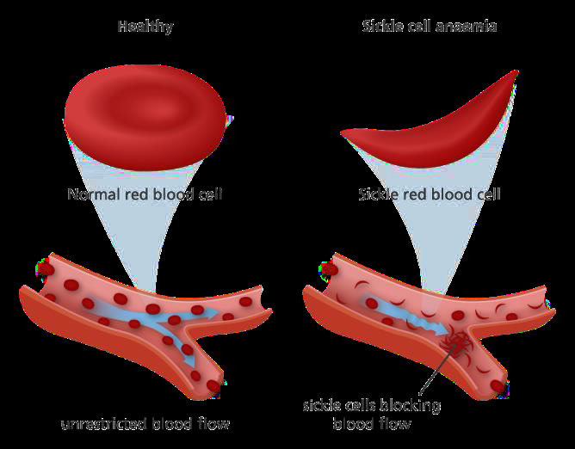
Sickle Cell Anemia and Cystic Fibrosis

Slide 43
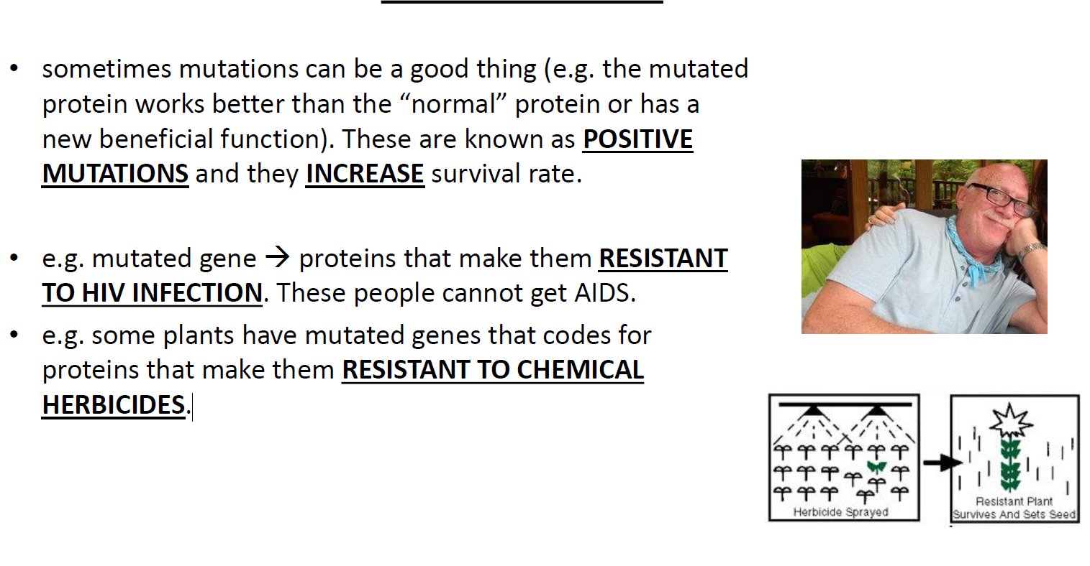

Slide 44
Effects of Mutations
Gene mutations may produce proteins that are beneficial or harmful to the organism, or may have no effect at all.
  Beneficial (positive)
  Neutral (no effect)
  Harmful
    (E.g. genetic diseases, cancer).

Slide 45
Beneficial Mutation (positive mutation)
There are millions of people infected with HIV and AIDS
  still no known cure or vaccine
Some individuals have been found to be resistant to the AIDS virus
  because they carry a mutated gene that produces instructions for a protein that can prevent HIV infection

Slide 46
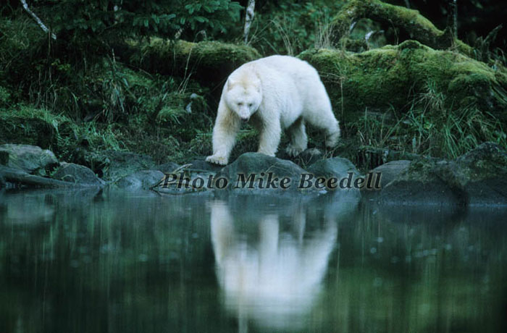
Neutral Mutation
A mutation that does not affect an organism.
  Ex. The gene mutation that results in the white coat colour of the spirit bear, since it does not increase or decrease the bear’s survival rate.

Slide 47
Harmful Mutation (AKA negative mutation)
Causes genetic diseases, such as Cystic Fibrosis
  CF is caused by a mutation in a gene which codes for a protein that helps move certain chemicals into & out of the cell.
  So the shape of the protein changes which and it can no longer do its job which cause the many symptoms of CF.
May cause Cancer

Slide 48
Causes of Mutations
Mutations can occur naturally during DNA replication and cell division. The human body has systems in place that will often fix errors in DNA replication, or destroy cells that are working abnormally due to mutations.
There are also factors in the environment that may increase chances for mutations to occur.

Slide 49
Mutagens are substances or factors that cause mutations
Environmental mutagens such as:
  Mercury
  cigarette smoke
  X-ray and UV radiation
  viruses
Correcting mutations is difficult, but new techniques such as gene therapy offer hope.

Slide 51
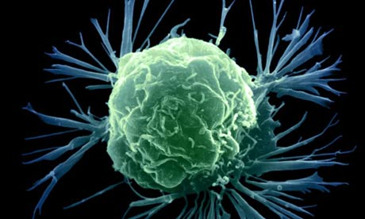
Cancer: Characteristics
Cancer is a disease in which cells divide very rapidly and uncontrollably.
Cells accumulate in masses called tumours. There are 2 types.
  Benign: stay in one place and don’t interfere with surrounding tissues
    Ex. Warts
  Malignant: invade surrounding tissues and interfere with normal functions
    Visible because of enlarged nuclei.

Slide 52
Cancer cont…
When cancer cells spread from original location this is called metastasis.
Substances that cause cancer are called carcinogens.
  E.g. pesticides, X-rays, some viruses, chemicals in tobacco.
Treatment methods include surgery, radiation, and chemotherapy.

