Slide 1
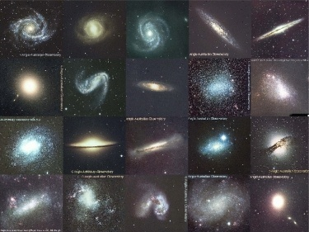
10.2 Galaxies
Galaxies are collections of stars, gas, and dust held together by gravity.
Scientists believe there are about 125 billion of these structures in our universe.

Slide 2
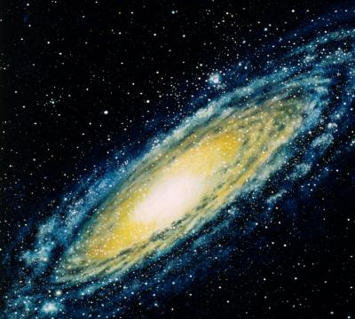
Galaxies
There are 3 basic shapes of galaxies: a) spiral, b) elliptical, c) irregular.
The Milky Way where our sun is located is a spiral galaxy.

Slide 3
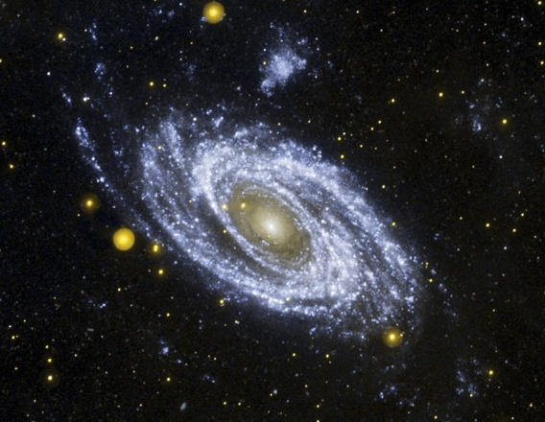
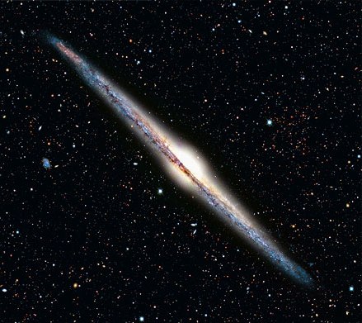
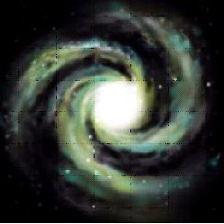
Galaxy Shapes
Spiral
These appear like pinwheels with many long arms spiralling out from the center.
The center bulge is made up of stars formed long ago, while the circling disc is made up of gasses and dust. This area is called the “halo.”

Slide 4
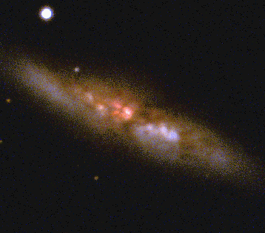
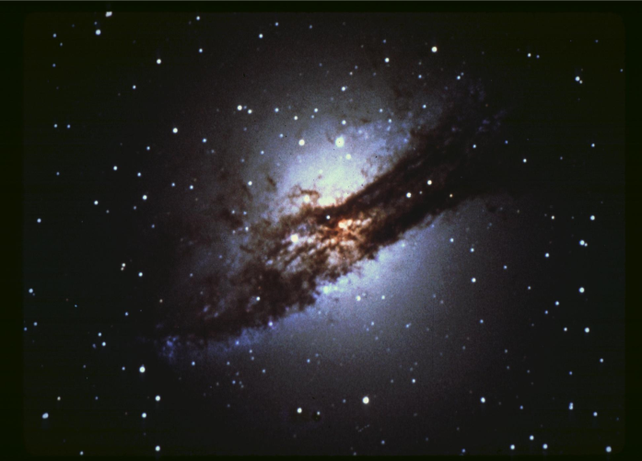
Galaxy Shapes
Eliptical
These galaxies contain some of the oldest stars in the universe. They range in shape from a football field to a cigar.
Over half of the galaxies are elliptical and many are also the largest.

Slide 5
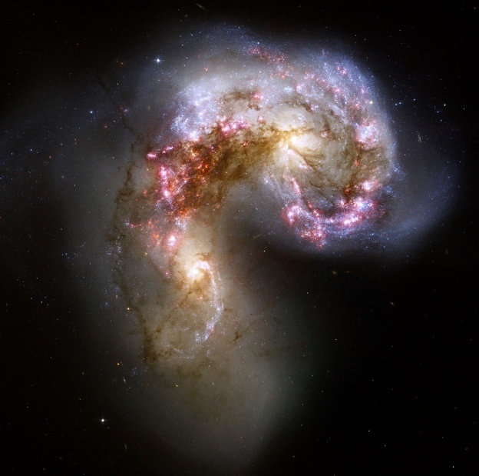
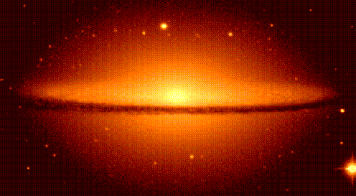
Galaxy Shapes
Irregular
These are made up of a mixture of new and old stars. They do not have distinguishing shapes like the elliptical or spiral galaxies.

Slide 6
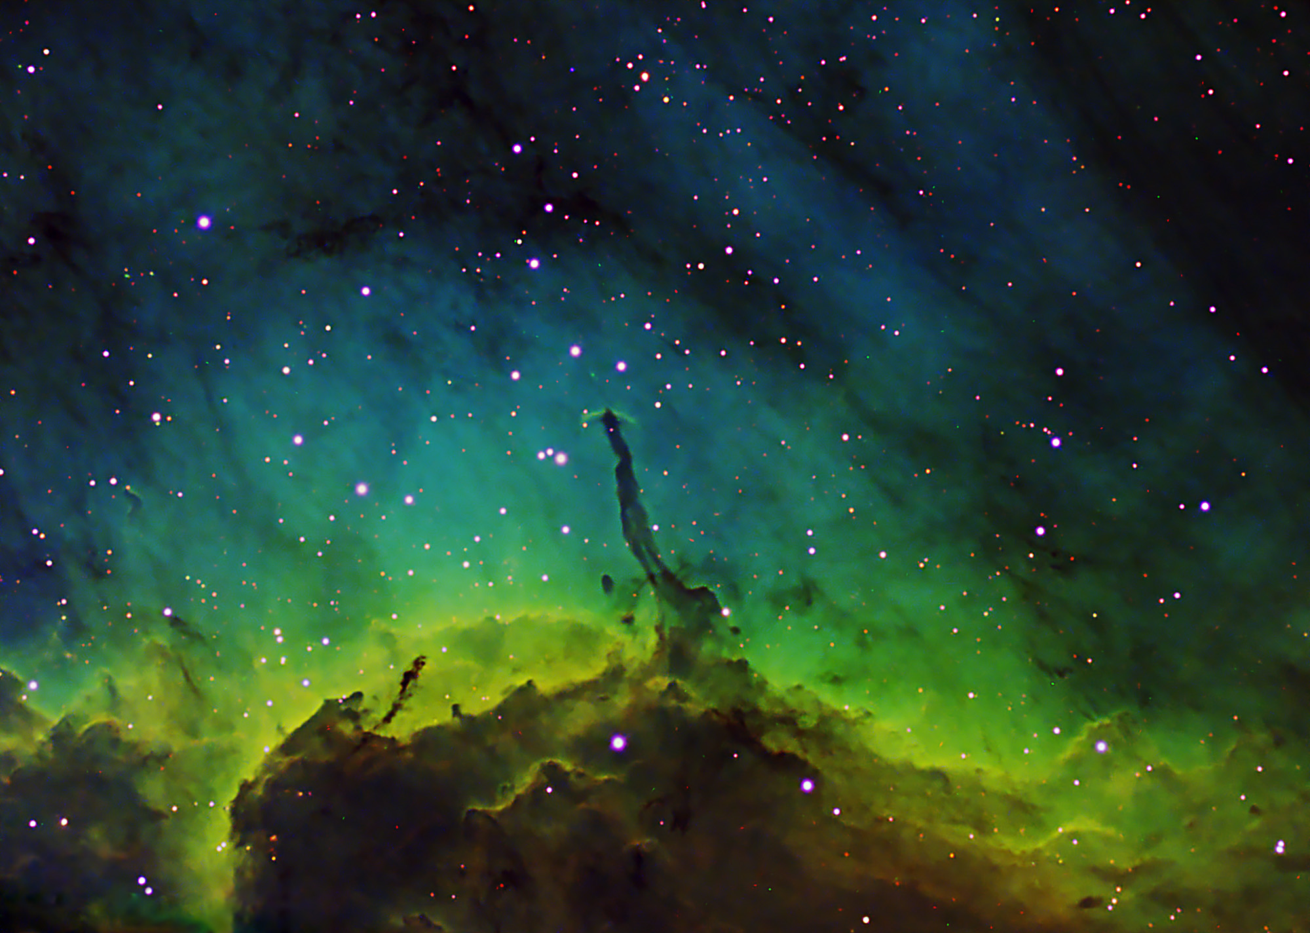
Other Differences Between Galaxies
Galaxies can also differ in size, mass, colour, brightness, and speed they spin.
These differences are determined by;
number of stars
amount and type of gas
dust
Some galaxies grow into supergiants while others remain dwarf.

Slide 7
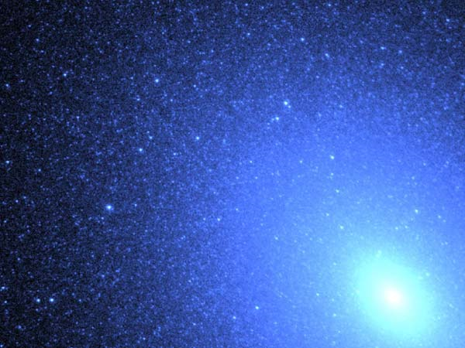
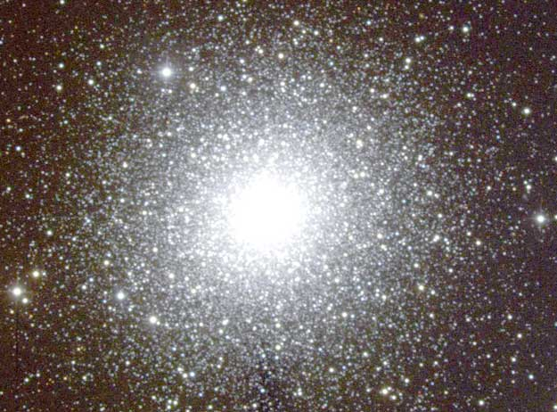
Star Clusters
One type is called a “globular cluster.” These are composed of as many as one million stars held together by their mutual gravity in a spherical shape.

Slide 8
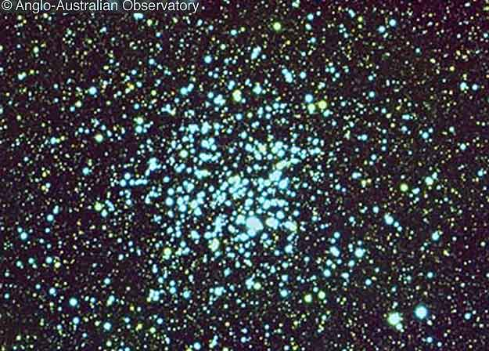
Star Clusters
The other type is called an “open cluster.” These only contain between a few hundred and tens of thousands of stars.

Slide 9
Section 10.2 Quiz

