Slide 1
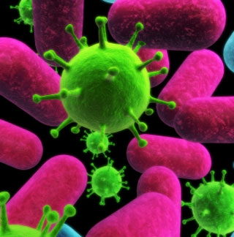
Viruses

Slide 2
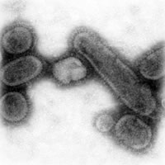
What is a virus?
A tiny, non-living particle.
Enters cells, takes over and reproduces inside of them.
An invader of cells.

Slide 3
Characteristics of Viruses
Are not cells.
Do not use their own energy to grow or respond to their surroundings.
Can not make food or waste.
Viruses can and do multiply

Slide 4
HOST
Viruses can ONLY multiply inside of a living HOST CELL.

Slide 5
HOST = an organism that provides a source of energy for a virus or another organism.
PARASITE = an organism that lives on or in a host and causes harm.

Slide 6
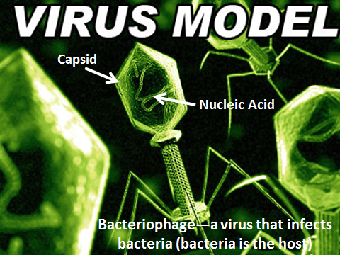

Slide 7
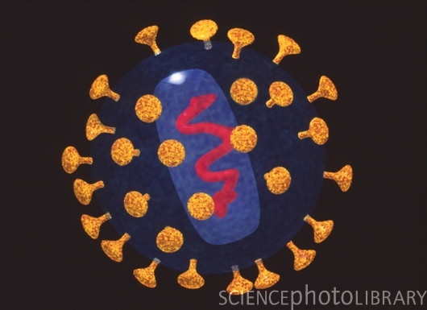
Viral Structure
All viruses have the same basic structure:
Nucleic acid core (DNA or RNA)
Capsid (Protein coat)

Slide 8
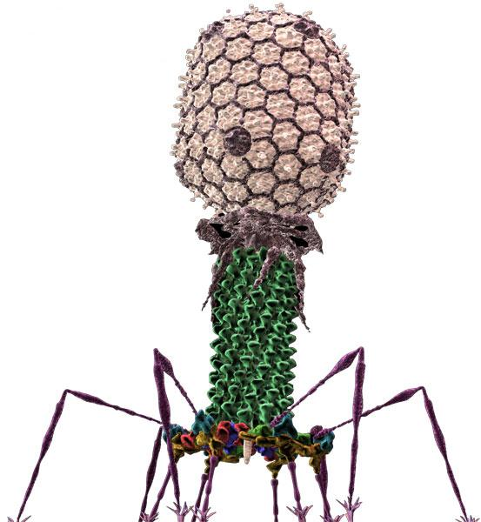
Viral Shapes
Bacteriophage
A virus that only infects bacteria.

Slide 9
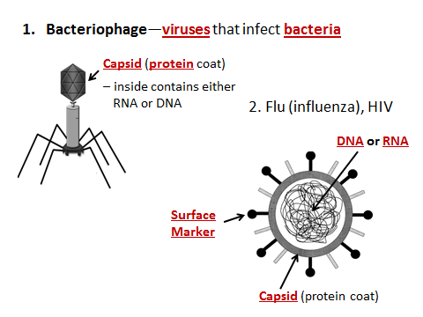

Slide 10
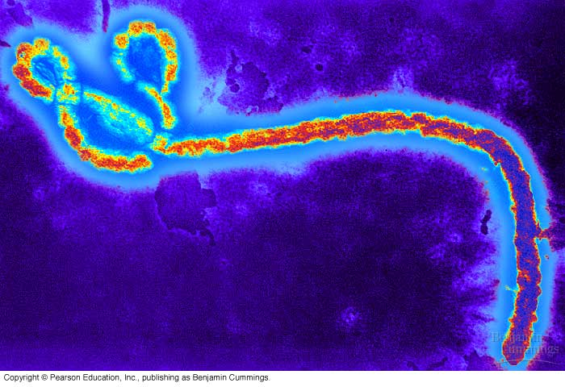
Examples of Viruses

Slide 11
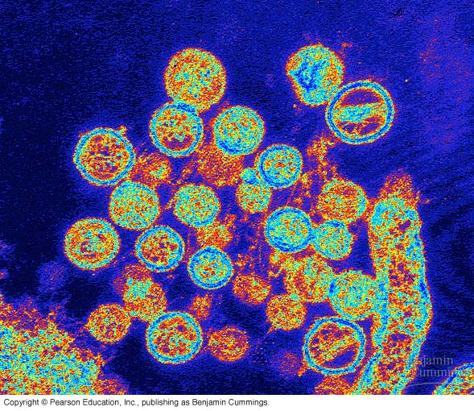

Slide 12
How Do Viruses Work?
In order to replicate and make copies of itself, viruses need a host cell. Any living cell can become a host cell (human, animal, plant, and even bacterial cells!)
Without a host cell, viruses cannot function (i.e.-are harmless!)
Although any cell can theoretically become a host cell, specific viruses will only infect specific cells
  (EX: HIV will only infect human T cells, a part of your immune system)

Slide 13
How Do Viruses Work?
Attach: The capsid of the virus binds to receptor proteins on the surface of a host cell, tricking the host cell into thinking it’s not a foreign invader.
Inject: The virus then injects its genetic material (DNA or RNA) into the host cell.
Assemble: The viral genes are expressed, turning the host cell into a virus-making factory.
Repeat: The host cell eventually bursts, releasing the hundreds of newly formed viruses to infect surrounding cells!
VIDEO CLIP:
How Viruses Work

Slide 14
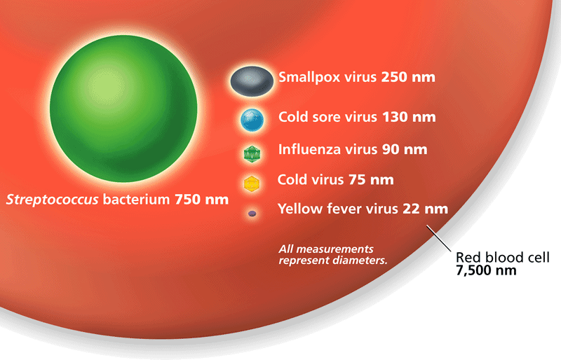
Viruses are VERY small and can not be seen without a powerful microscope.

Slide 15
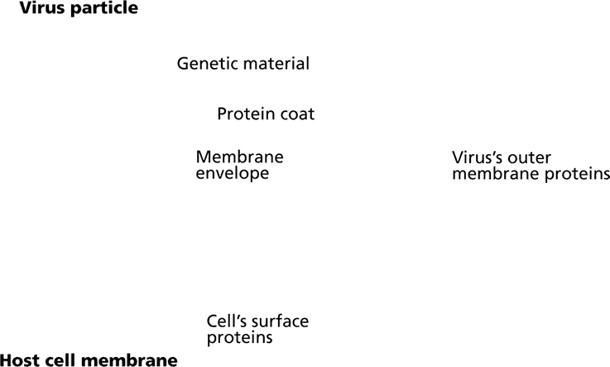
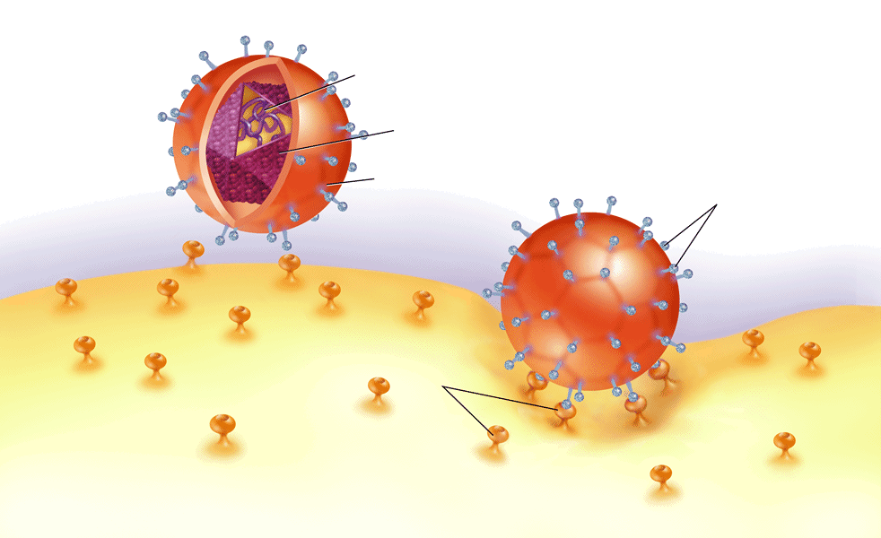
Viruses have a protein coat and genetic material.

Slide 16
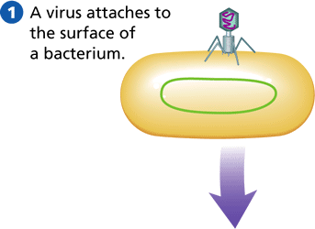
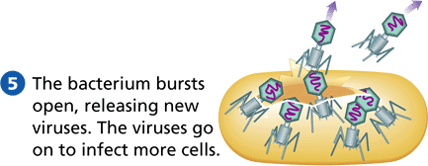
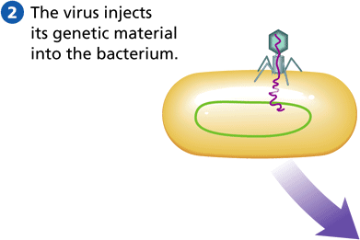
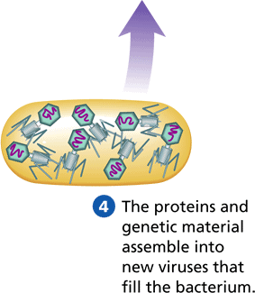
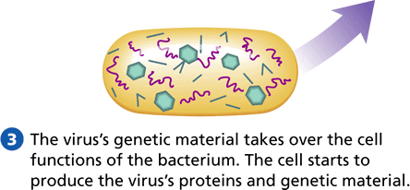

Slide 17
Active Viruses
Enter cell.
Take over cell functions.
Produces more viruses.
Cell bursts releasing lots of new viruses.
Those viruses infect more cells.

Slide 18
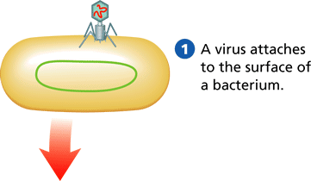
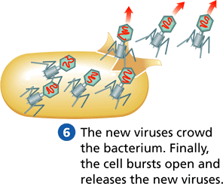
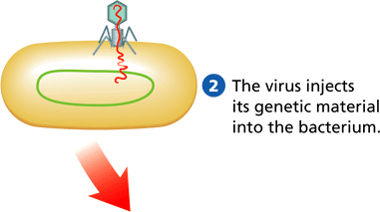
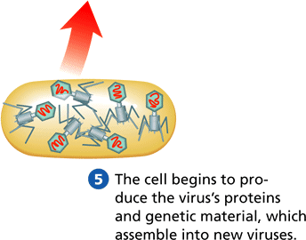
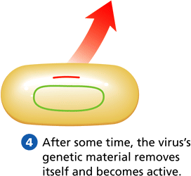
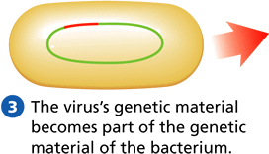

Slide 19
What is the difference
between an active and hidden
virus?
The genetic material of a hidden virus can “hide” inside of the cell.
It is undetected or hidden so the cell can not attack the virus!
You can NEVER get rid of a hidden virus…EVER.

Slide 20
Viruses
Viruses can cause disease in humans, animals, plants, and even bacteria!
Viruses can cause a variety of diseases:
  Common cold – Polio
  Hepatitis A, B & C – Influenza
  Herpes – Mumps
  Mononucleosis – Measles
  Warts – Viral Meningitis
  Chickenpox – AIDS
VIDEO CLIP:
Viral Disease

Slide 21
Protection
There are a few big ways to protect yourself against pathogens (disease causing agents)
  Antibiotics (drugs to kill bacteria)
  Antivirals (drugs to treat viruses)
  Vaccination (using your body’s own immune system to preemptively guard against attack)

Slide 22
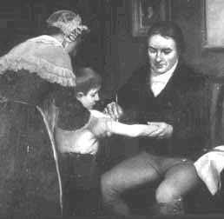
Jenner
Creator of 1st vaccine with smallpox
Injected a little boy with live cow pox.
Sent him into a smallpox infected area.

Slide 23
Antibiotics
Antibiotics can only be used to treat bacterial infections!
Target specific structures on bacteria to kill them.
First made from a fungus (penicillin), now most are made artificially.
Unfortunately, antibiotic resistance (where the antibiotic doesn’t kill the target bacteria anymore) is becoming a major problem.

Slide 24
Antivirals
Antivirals can only be used to treat certain viral infections!
Does not “kill” or disarm the virus permanently; only shortens symptoms by 1-2 days.
Usually only prescribed to patients with life threatening symptoms or those that have a greater chance of developing complications (because of their age or they have a high-risk medical condition).
Just like antibiotics, there is evidence of antiviral resistance too!

Slide 25
Vaccination
Vaccines can only be used to prevent infections (both viral and bacterial) from leading to disease.
“Trick” your immune system to make antibodies that destroy foreign “bodies” or particles (such as bacteria and viruses). Your body remembers (memory cells) how to make these antibodies when the real thing invades.
Made from a weakened virus, inactivated virus, or by using only part of the virus/bacteria itself.
VIDEO CLIP:
Vaccination

Slide 26
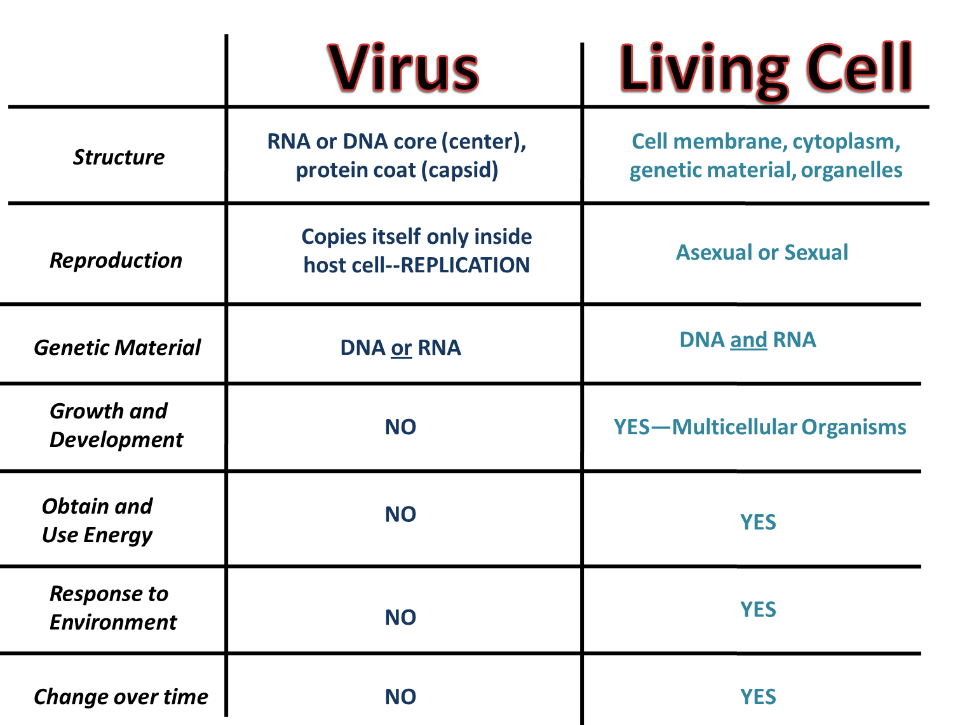

Slide 27
To Review....
What are the differences between viruses and bacteria?
Are all bacteria harmful? Explain.
When you get a cold, should you take an antibiotic to help you get better? Why?
What’s the best and easiest thing to do to avoid getting sick?

Slide 28
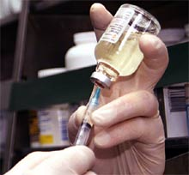
Vaccines of Today
Measles
Mumps
Rubella
Polio
Flu
Chicken Pox*
HPV (Human Papilloma Virus)*
Hepitis
Rabies

Slide 29
Bacteria
Virus
Both

Slide 30
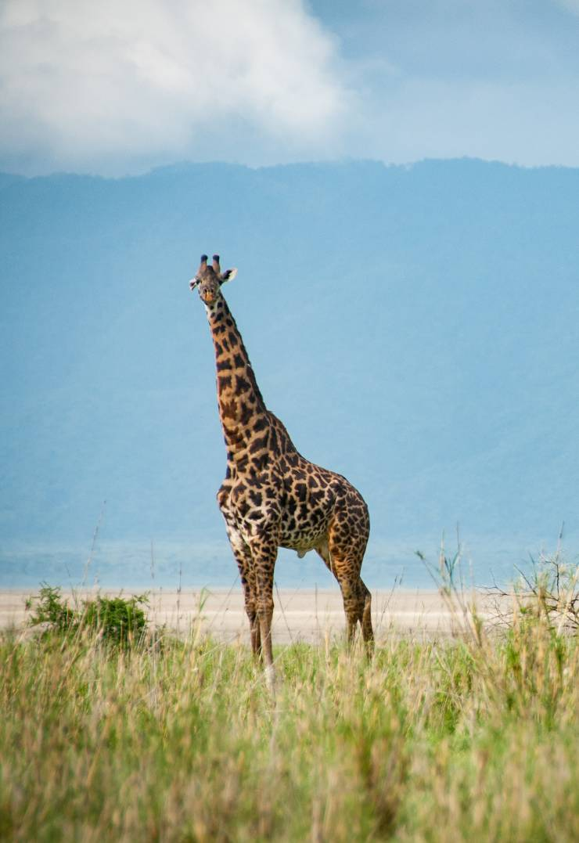
Foreign travel
Over recent decades there has been a huge increase in the number of people going to Africa on ‘safari’ holidays.
The increase in the number and quality of wildlife programmes on television probably inspires people to travel and experience the African environment for themselves.
Kenya and South Africa are among the popular destinations.

Slide 31
Travel vaccination
All visitors to Kenya are required to have vaccinations for the following five diseases: Yellow Fever, Tetanus, Hepatitis A, Typhoid and Poliomyelitis.
Those who wish to go trekking need two additional vaccinations: Hepatitis B and Rabies. Three further vaccinations are required for people visiting rural populations in Kenya (for Diphtheria, Meningococcal Meningitis and Tuberculosis).

Slide 32
Why are these vaccinations required?
Thankfully, these serious diseases are uncommon in Ireland and so the risk of infection is low. However, they are much more common in Africa and so the risk of being infected – and of infecting others – is greater. Some are caused by viruses and others are caused by bacteria.
A vaccine contains non-infectious bits of the disease-causing organism and this triggers the body’s immune system to produce antibodies against the disease. For complete immunity two or more doses of the vaccine may be required, depending on the disease.

Slide 33
Why are these vaccinations required?
Once a person’s immune system has been trained in this way to recognise a particular infection it can then respond quickly to the real infection, if it occurs

Slide 34
Eradication of disease
Vaccination has led to the complete eradication
of smallpox.
Thanks to vaccination fewer children were paralysed by polio in 2017 than ever before, with the polio virus now limited to a few areas in Afghanistan, Pakistan and Nigeria.
There are 3 different polio viruses. Polio type 2 was officially declared eradicated by vaccination in 2015; type 1 has not been found since 2012. Type 3 is the only remaining strain of polio ‘in the wild’.

Slide 35
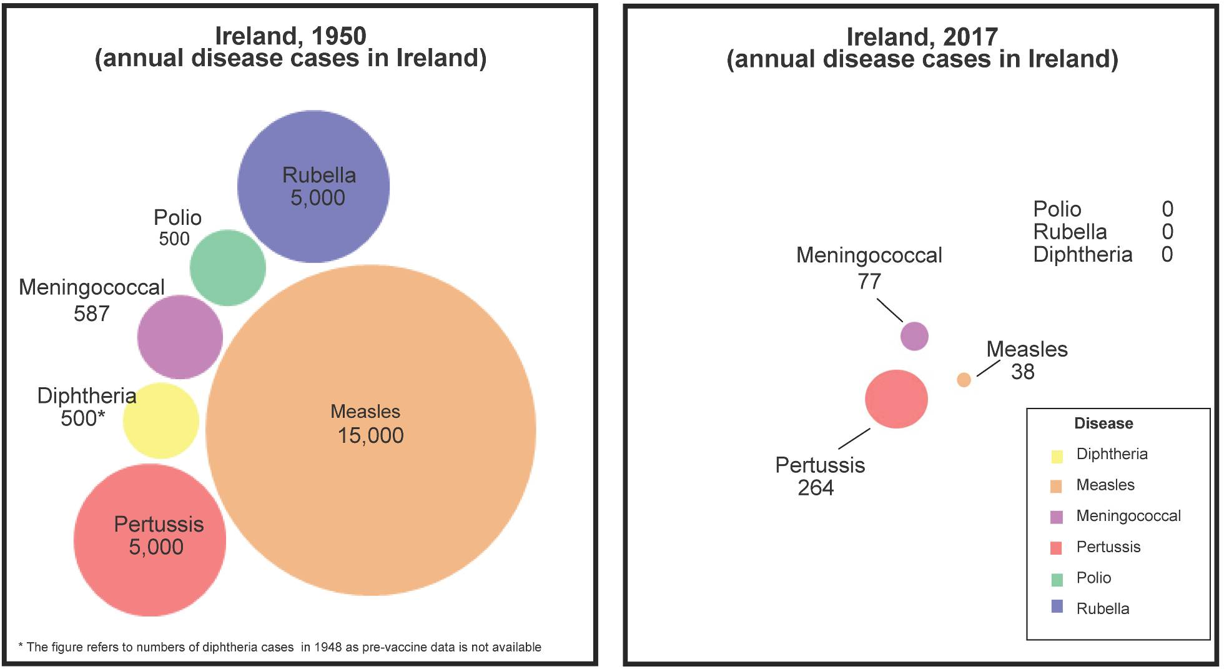
Vaccines do really work. Comparison 1950 & 2017.

Slide 36
Herd Immunity
Herd Immunity develops when 95% of the population are vaccinated against highly infectious diseases like measles. This prevents the disease from spreading because there are fewer people who can be infected.
Herd immunity gives protection to vulnerable people, e.g. babies who are too young to be vaccinated, and children and adults who cannot be vaccinated because of illness or treatment that affects their immune system.

Slide 37
Cervical cancer
Cervical cancer is not a trivial disease. The risk of getting cervical cancer is dramatically reduced by vaccination. (In Scotland the HPV vaccination programme established in 2008 has reduced HPV infections by 90%!)
In Ireland 300 women get cervical cancer every year and 90 die from the disease. Most cervical cancers are caused by two of the many types of human papillomavirus (HPV). About 70% of cervical cancers are caused by HPV types 16 & 18.

Slide 38
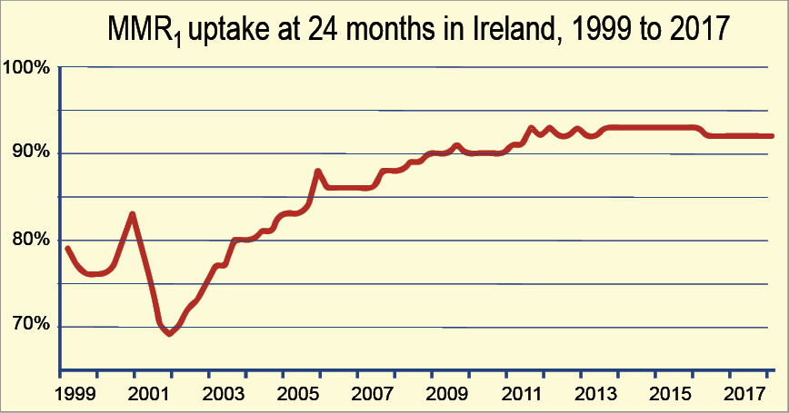
Uptake of MMR vaccine still below recommended 95%

Slide 39
Measles
There are regular outbreaks of measles in Ireland and in the EU because measles vaccination (MMR) has not reached the WHO 95% target level.
Measles infection can lead to long term deafness
or intellectual disability and is sometimes fatal.
In August 2018, more than 41,000 cases of
measles and 37 measles related deaths were reported across Europe during the first six months
of the year.
In 2017 there were 14,451 measles cases and 36 deaths reported across Europe for the whole year.

Slide 40
MMR vaccine
Two doses of MMR vaccine are required to give the best protection. In Ireland, the first dose is given at 12 months by GPs and the second dose is given to Junior Infants.
Because of the resurgence of measles in Europe anyone less than 40 years of age should ensure they are fully vaccinated against measles.

Slide 41
Whooping Cough (Pertussis)
There were 264 reported cases of pertussis in 2017 in Ireland. Infants have died in Ireland because of pertussis. Many pertussis cases have been reported in babies less than 6 months of age who are too young to be fully vaccinated.
Therefore to protect infants mothers are recommended the Pertussis (Tdap) non live vaccine after 16 weeks and up to 36 weeks in pregnancy. The antibodies developed cross the placenta to the infant and protect the infant through the first months of life from pertussis infection.

Slide 42
Meningococcal C disease
Meningococcal C infection is commonest in children under one year of age; the next most commonly affected group are those aged 1 to 4 years of age and then teenagers. Therefore MenC vaccine is given to children under the age of 1, with booster doses at 12 months, and in first year of second level school.
Uptake of this vaccine has also never reached the 95% recommended level. Seriously ill unvaccinated children have been admitted to hospital in 2018 with invasive meningococcal C disease.

Slide 43
Influenza
Fortunately many of the diseases for which vaccines are available do not evolve very quickly and so once we have been vaccinated we remain immunised against these diseases.
However, in the case of influenza different strains appear each winter and a different vaccine is required to confer immunity.
There are two main types (A & B) of ‘flu virus and there and many subtypes.

Slide 44
During the winter 2017-2018 in Ireland thousands of people got the ‘flu and about 4,500 people were hospitalised. Two hundred and twelve people died from ‘flu.
‘Flu vaccine is recommended not only for all aged 65 years and older and for all pregnant women, but also for anyone with a chronic medical condition, including moderate or severe asthma.

Slide 45
Further information
For further information see:
www.immunisation.ie
www.hpsc.ie
https://www.rcpi.ie/policy-and-advocacy/nationalimmunisation-advisory-committee/
You can find out more about the work of the NIO at:
www.hse.ie/eng/health/Immunisation/whoweare/

Slide 46
Student Activities - 1
Edward Jenner is credited with the invention of vaccination.
Summarise what he did and discuss whether it would be allowed today.

Slide 47
Student Activities - 2
Why do you think some people are reluctant to be vaccinated against particular diseases?
Explain how this not only endangers their own health but also the health of the community.

Slide 48
Student Activities - 3
What are the most important vaccinations that Irish children should receive?
What diseases do they counter and how effective are they in preventing disease?

Slide 49
HPV vaccine
The HPV vaccine, which is given free to school girls, protects them from HPV infection, caused by HPV types 16 & 18, as well as protecting them from developing cervical cancer in later life. If more than 20% of girls are not vaccinated then the reservoir of the virus in the population remains high and so does the probability of infection.

Slide 50
Questions to Accompany Viruses Power Point
1. What is a virus?
2. Is virus alive?
3. Name 2 characteristics of viruses.
4. What is the difference between a host and a parasite?
5. List 3 viruses that were named in the presentation.
6. What is the difference between an active virus and a hidden virus?
7. What did the scientist named Jenner discover?

Slide 51
Answer Key
1. What is a virus?
A virus is a non-living particle that takes over a host cell and reproduces.
2. Is virus alive?
That is still debated. It is generally considered non-living because it cannot reproduce on its own.
3. Name 2 characteristics of viruses.
Are not cells, cannot make food or waste, do not use their own energy.
4. What is the difference between a host and a parasite?
The host is infected and harmed by the parasite. It takes over the cell and uses the cell to its own benefit.

Slide 52
5. List 3 viruses that were named in the presentation.
Ebola, Hanta, Smallpox, Flu…
6. What is the difference between an active virus and a hidden virus?
An active virus gets into the cells of the host and makes new viruses. The host cells are destroyed very quickly. A hidden virus gets into the genetic material of the host cell. It can wait for a very long time to become active. Even when it does, other cells are already infected with hidden viruses and do not become active.
7. What did the scientist named Jenner discover?
Jenner is credited with creating the very first vaccine (using cowpox).

